Slide 1
CS97: Introduction to Data Science
04: Model Evaluation and Selection
Instructor: Shichang Zhang
shichang@ucla.edu

Slide 2
Announcement
Homework 1 will be published by 1 pm today (June 26th):
Deadline for turning in hw1 is Friday (June 28th) at 10 pm
Your TA will help you with your hw in the afternoon section

Slide 3
So far…
We have learned
In linear regression, the response variable Y is a linear function of predictors
The parameters can be learned based on a set of training data points
Exact or gradient descent
For the same dataset and same response variable, we can build different linear regression models
E.g., which predictors to include, max degree in polynomial regression

Slide 4
Next
How to compare two different models?
How to overcome overfitting?
How to select the best model?

Slide 5
Content
Model Evaluation
Overfitting
Model Selection
Cross Validation
Bias vs Variance
Regularization: LASSO and Ridge

Slide 6
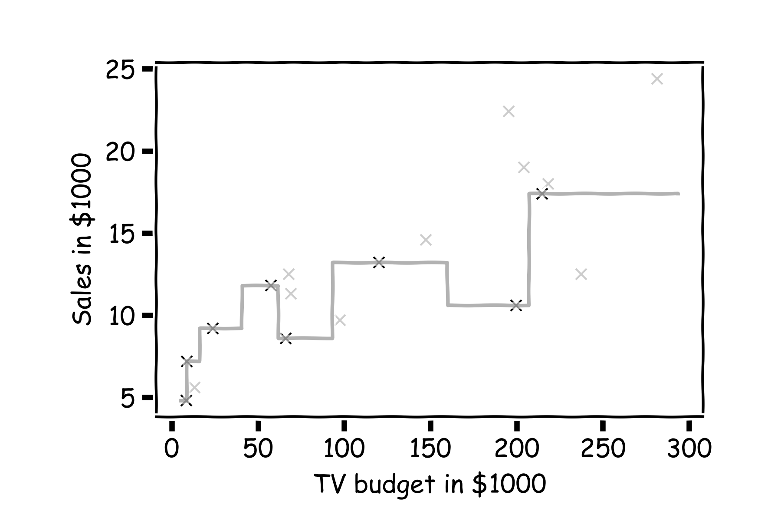
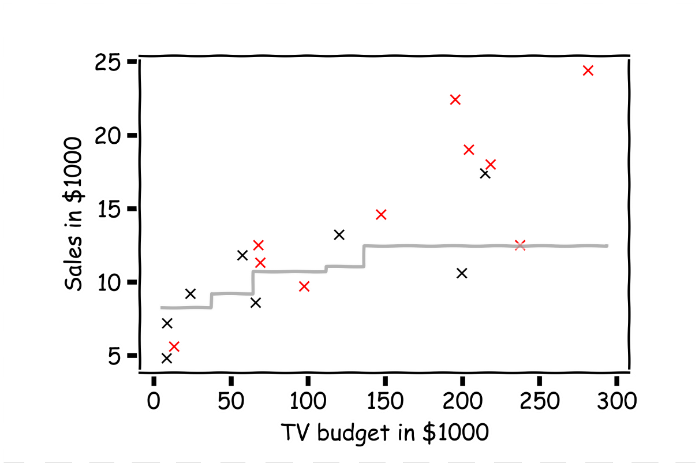
Model Evaluation
How to decide
Whether a model is good?
Which model is better?
f(x) vs. f’(x)

Slide 7
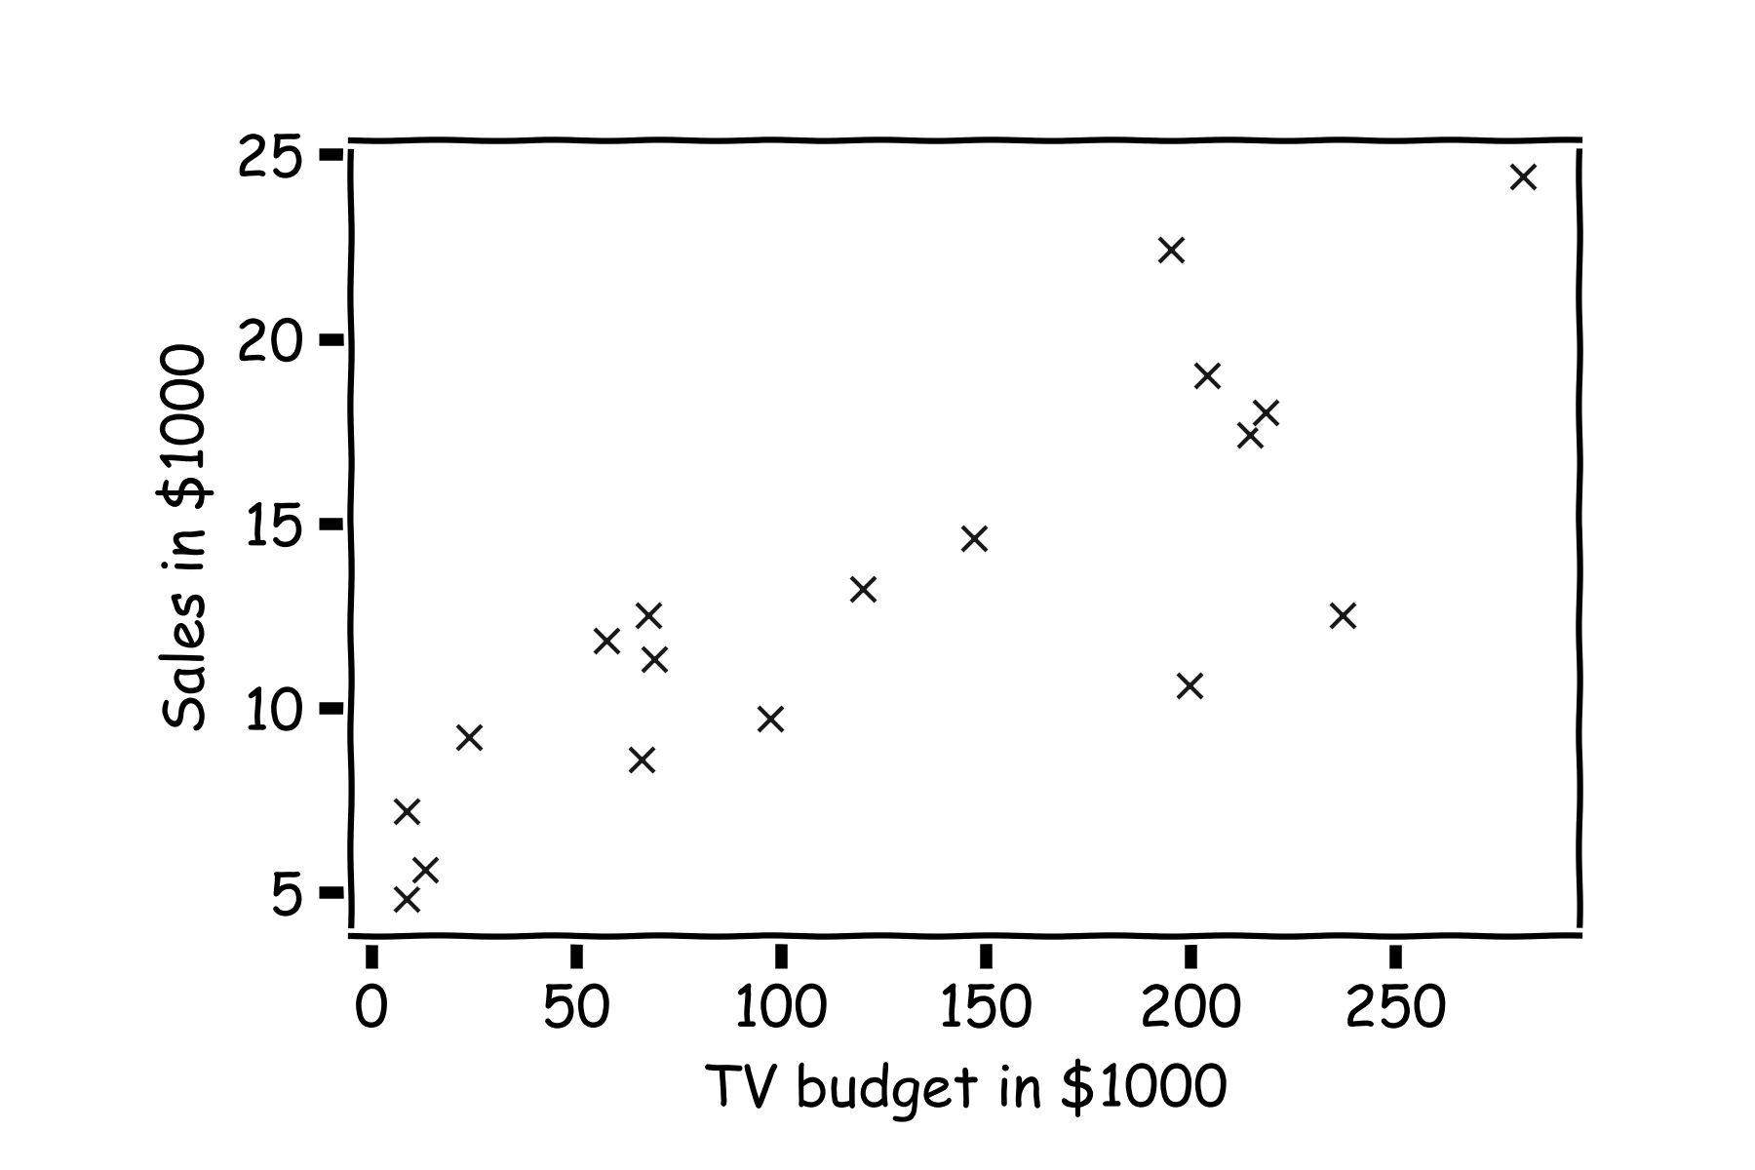
Error Evaluation
Start with some data.
Notes:
Change indeces and show k-nearest
Hint: I gave you a poll, a subset of you answered!

Slide 8
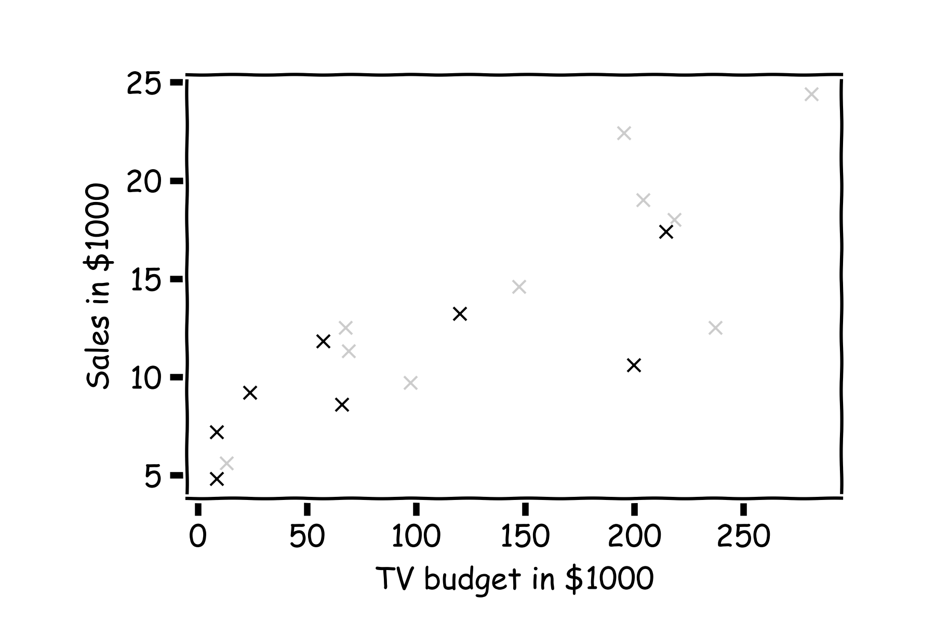
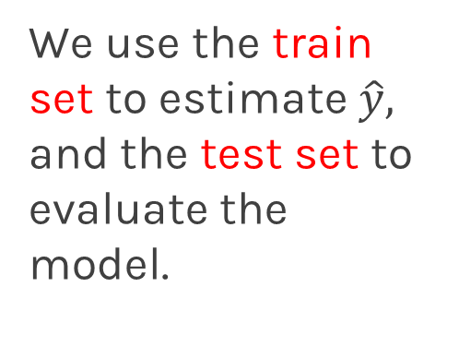
Error Evaluation
Hide some of the data from the model. This is called train-test split.
We use the train set to estimate $\hat{y},$ and the test set to evaluate the model.

Slide 9
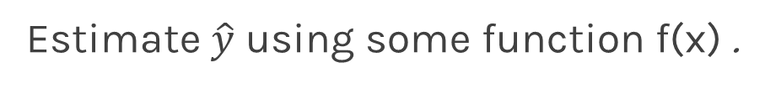
Error Evaluation
Estimate $\hat{y}$ using some function f(x) .
Notes:
Change indeces and show k-nearest

Slide 10
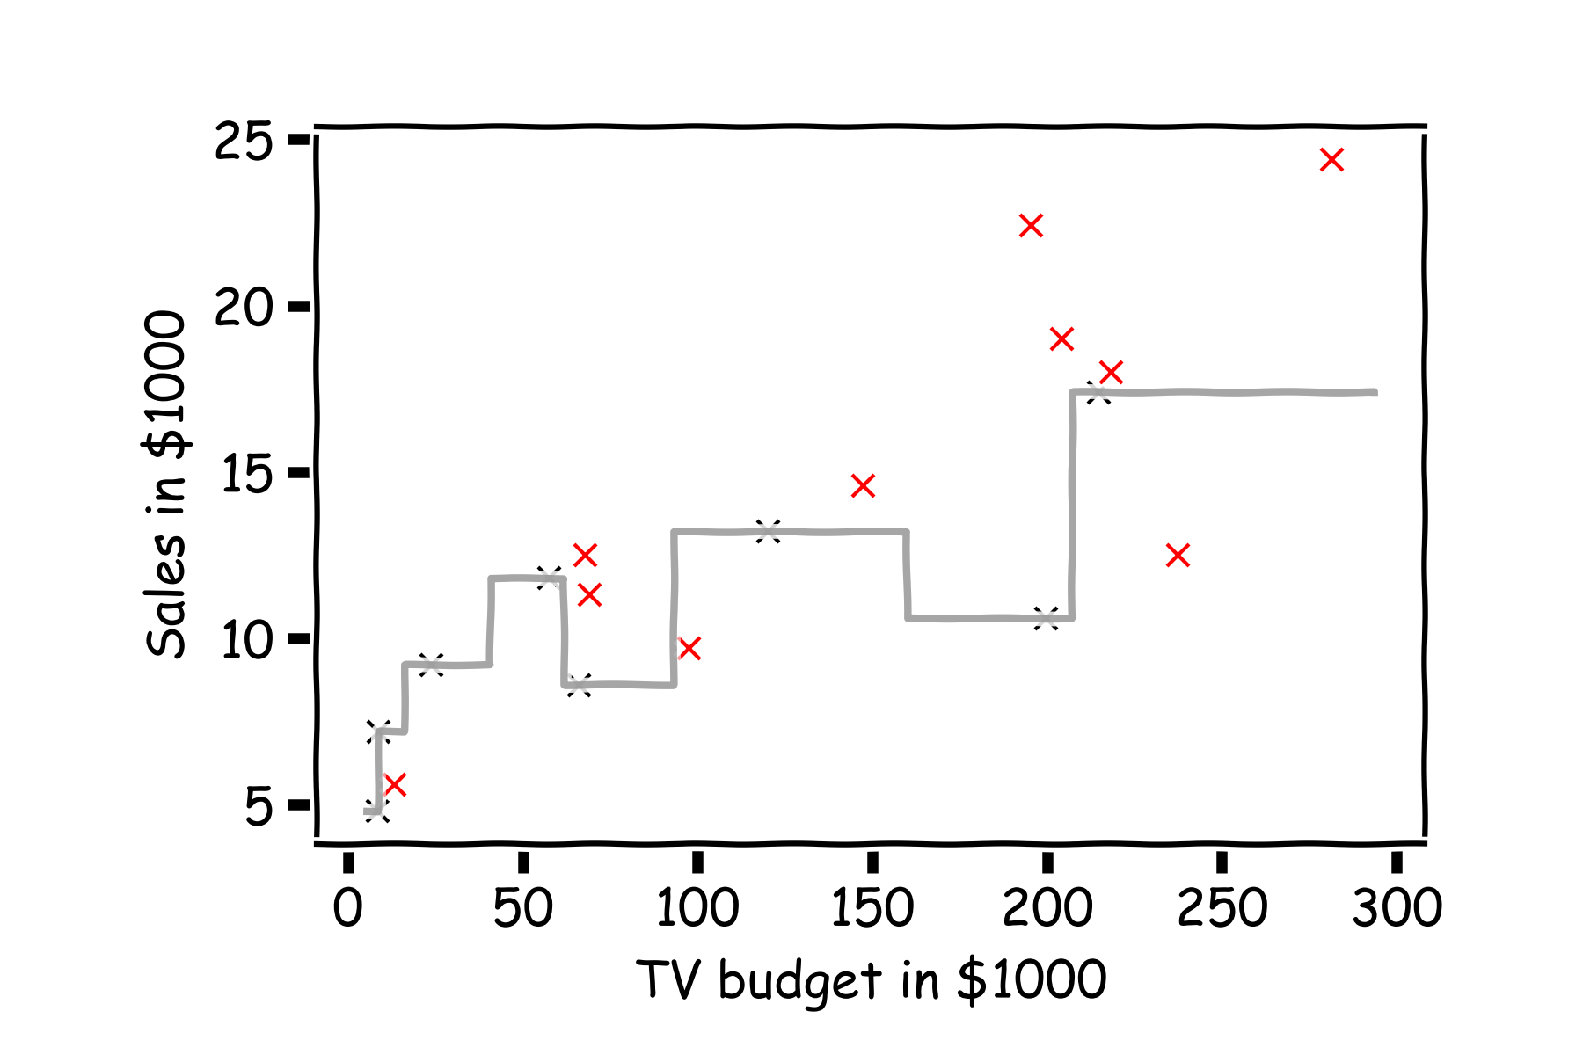
Error Evaluation
Now, we look at the data we have not used, the test data (red crosses).
Notes:
Change indeces and show k-nearest

Slide 11
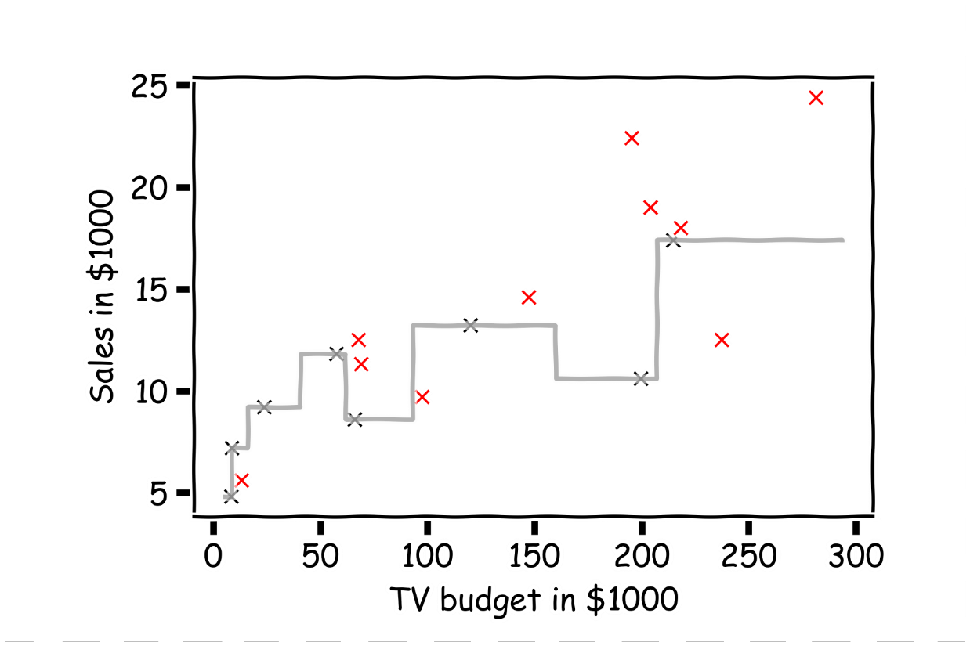
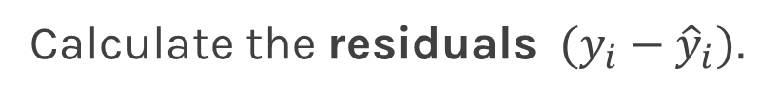
Error Evaluation
Calculate the ${\text{residuals} (y}_{i}−{\hat{y}}_{i}).$
Notes:
Change indeces and show k-nearest

Slide 12

Error Evaluation
Do the same for another function f’(x).
Notes:
Change indeces and show k-nearest

Slide 13
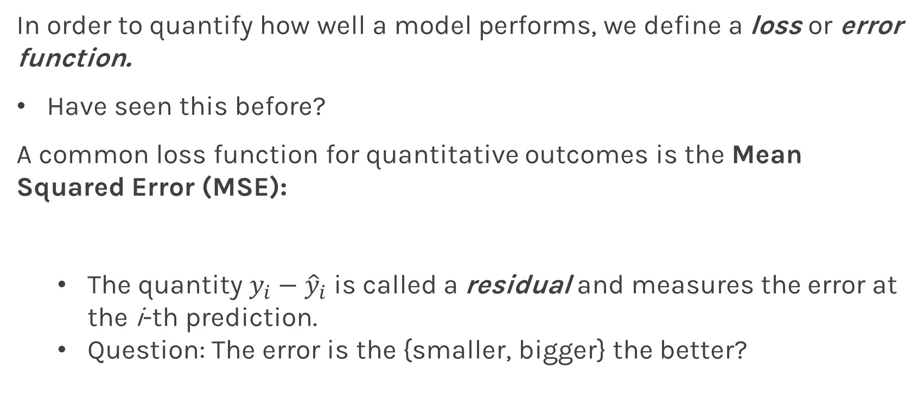
Error Evaluation
In order to quantify how well a model performs, we define a loss or error function.
Have seen this before?
A common loss function for quantitative outcomes is the Mean Squared Error (MSE):
The quantity $y_{i}−{\hat{y}}_{i}$ is called a residual and measures the error at the i-th prediction.
Question: The error is the {smaller, bigger} the better?
Notes:
Change indeces and show k-nearest

Slide 14
Error Evaluation
Caution: The MSE is by no means the only valid (or the best) loss function!
Question: What would be an intuitive loss function for predicting categorical outcomes?
Note: The square Root of the Mean of the Squared Errors (RMSE) is also commonly used.
Notes:
Do you want to mention that RMSE isn’t always great b/c it’s not smooth? This would give them an idea on the things to consider when choosing loss functions. (DLS)
MAE: mean absolute error (RMSE is easier to solve, but MAE is more robust to outliers) MAE: l1 vs MSE: l2
MSE=> mean, MAE=>median (more robust, but the gradient is the same for all) Idea: gradient=0
Categorical: 0-1 loss

Slide 15
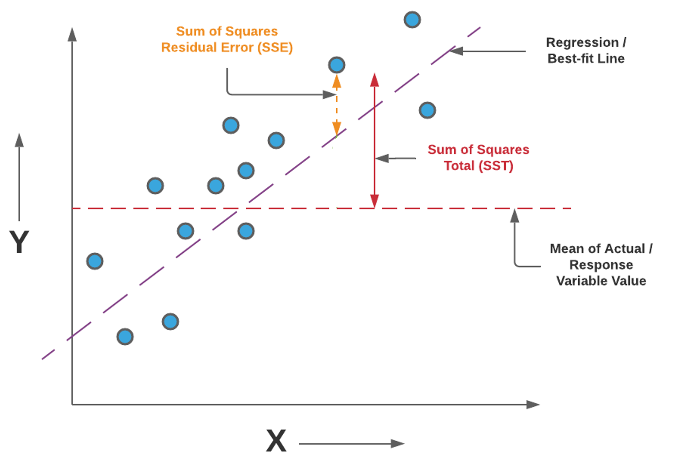
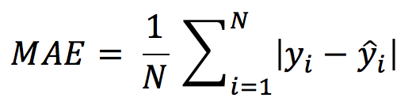
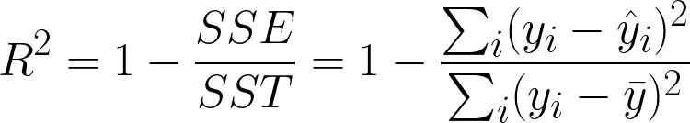
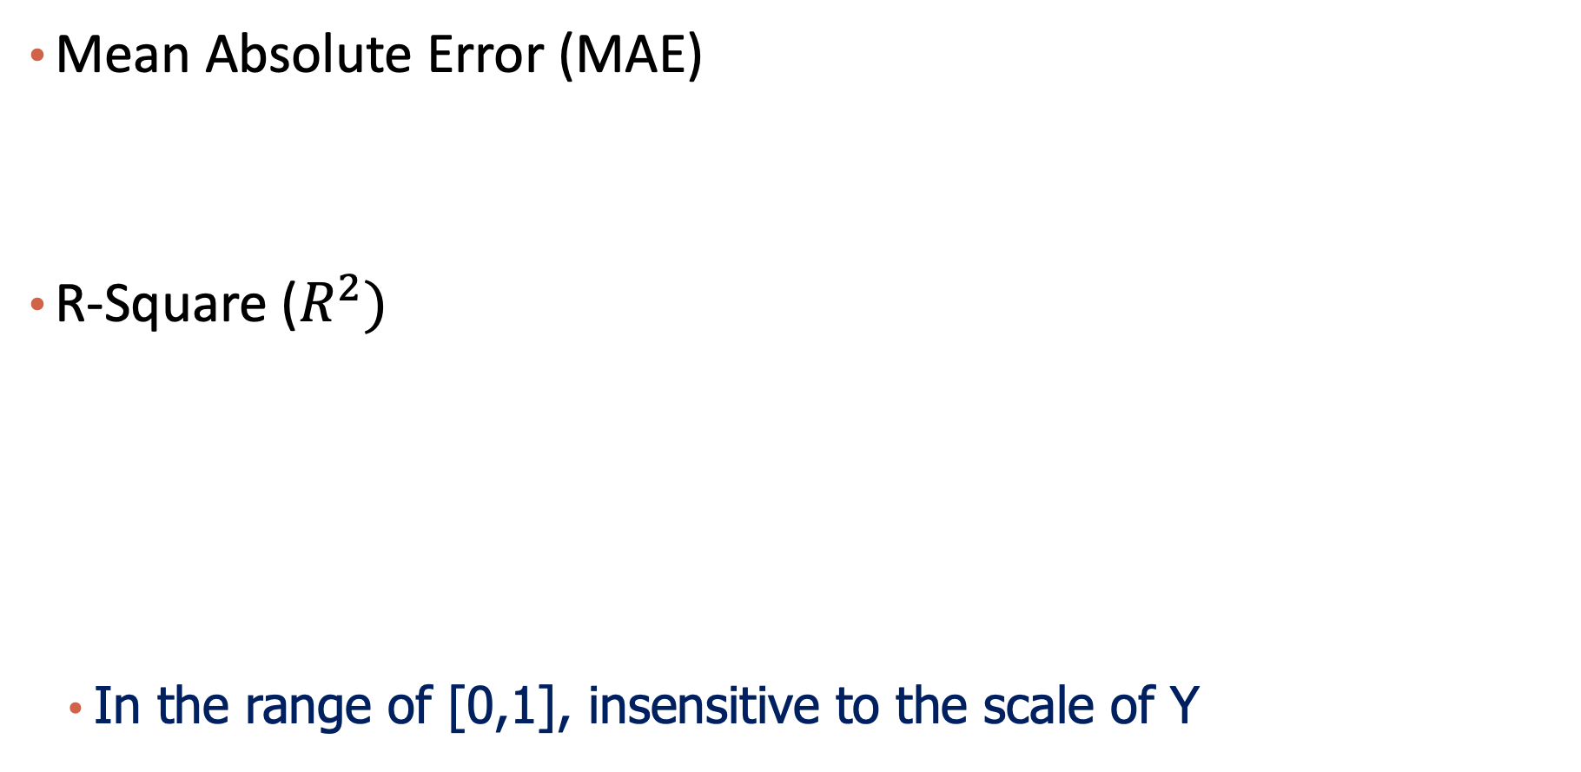
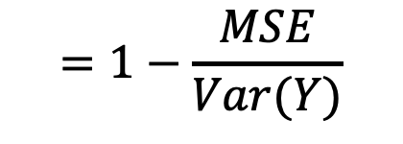
Other Evaluation Metrics
Mean Absolute Error (MAE)
R-Square ($R^{2})$
In the range of [0,1], insensitive to the scale of Y
$$=1−\frac{MSE}{Var(Y)}$$
Notes:
Can MSE be larger than Var(Y)? No… It has to be better. Otherwise \beta_0 = Y bar, and others = 0 should be smaller and will be output by the linear model.

Slide 16



Please download and install the Slido app on all computers you use
Audience Q&A Session
ⓘ Start presenting to display the audience questions on this slide.

Slide 17
Content
Model Evaluation
Overfitting
Model Selection
Cross Validation
Bias vs Variance
Regularization: LASSO and Ridge

Slide 18
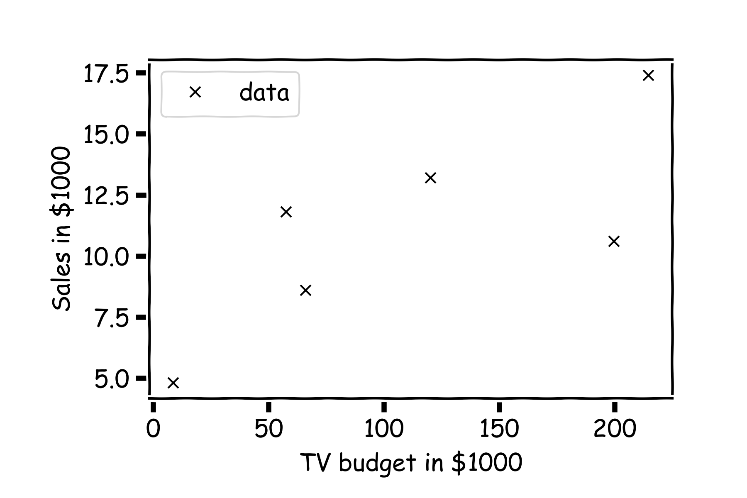
Training Error vs. Test Error

Slide 19
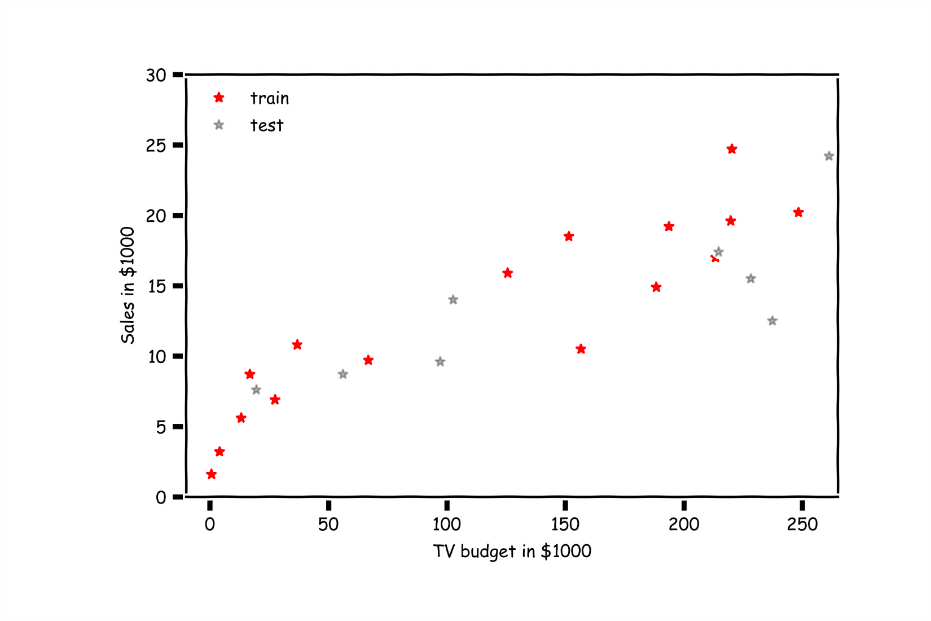
Overfitting

Slide 20
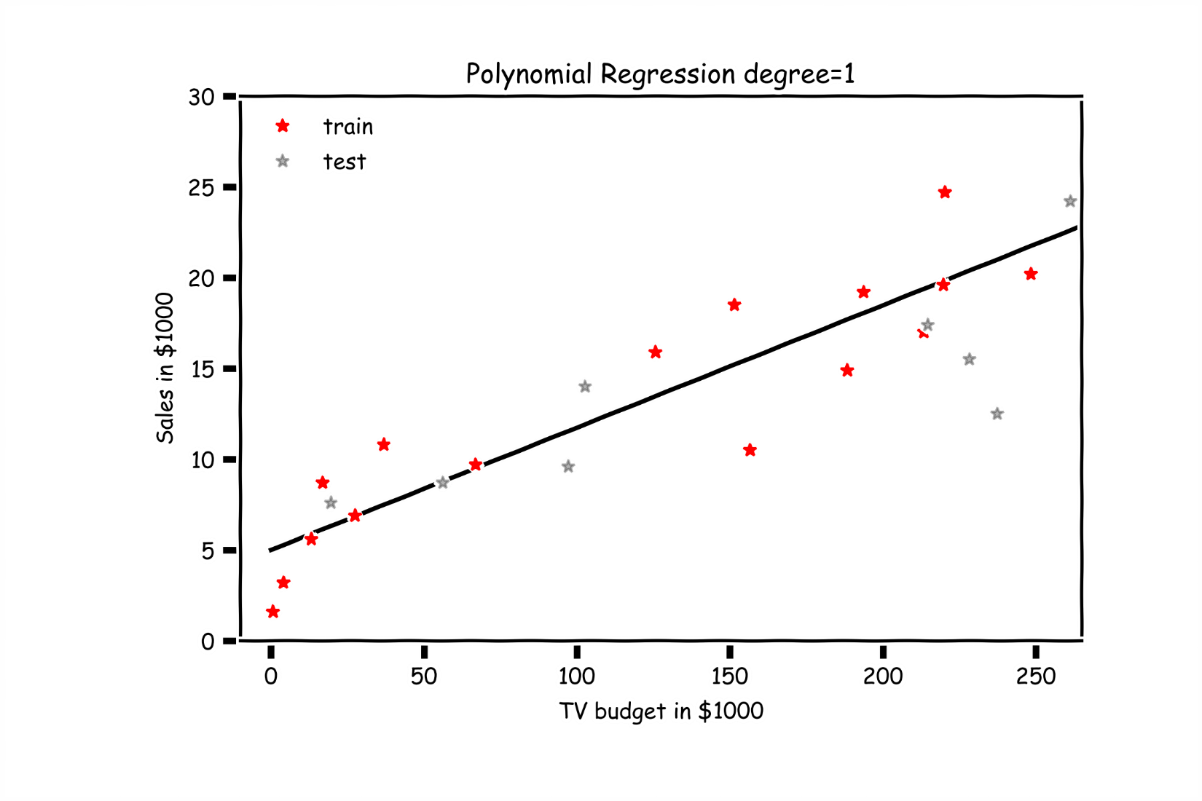
Overfitting

Slide 21
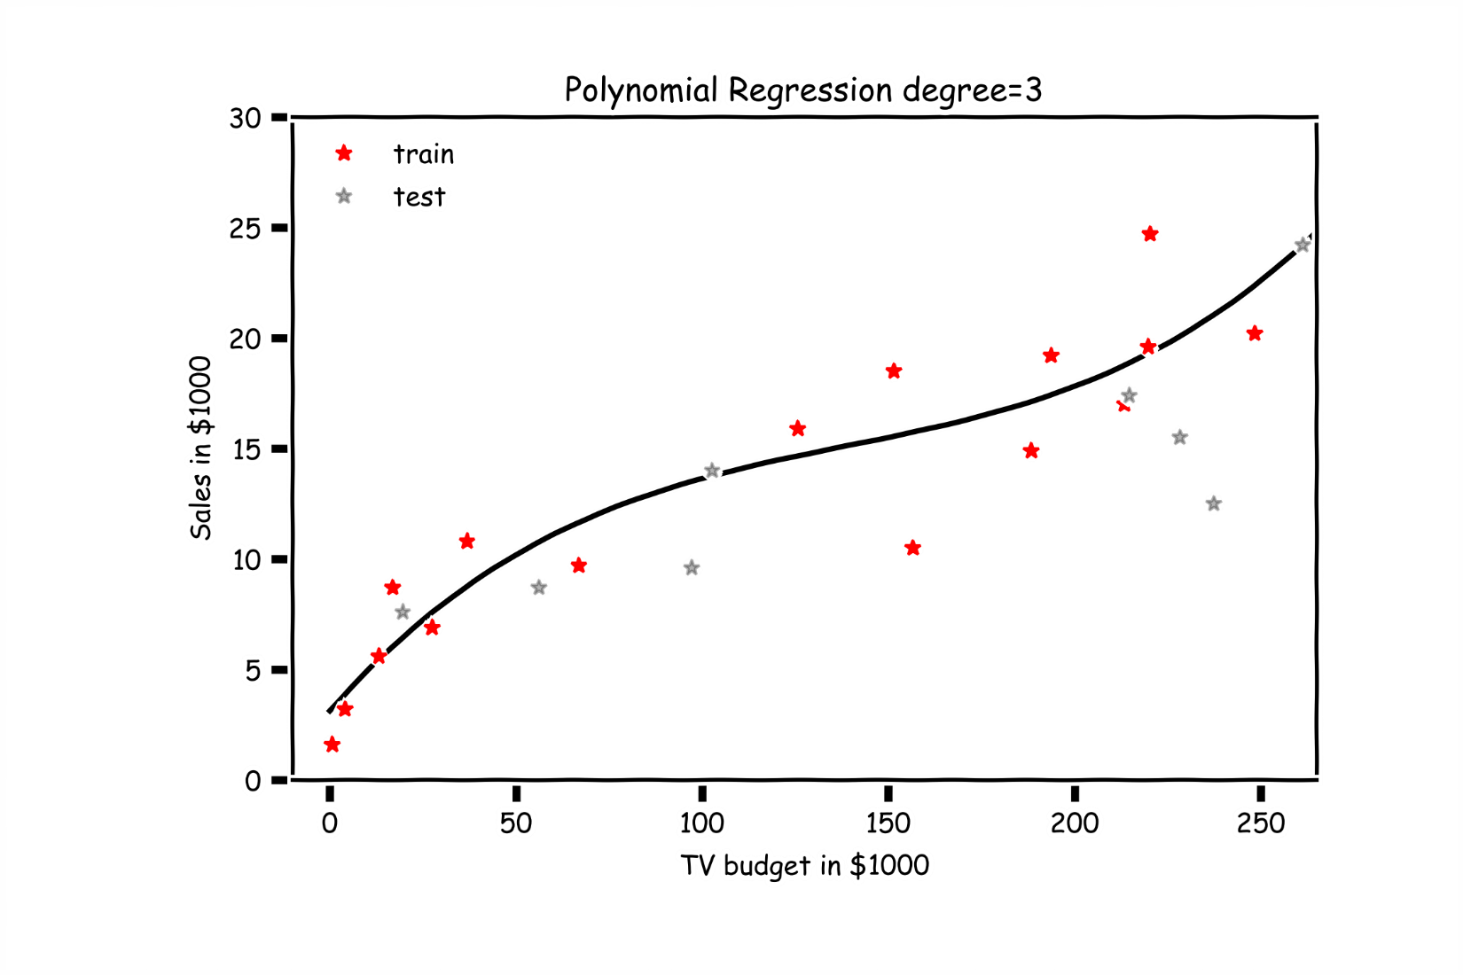
Overfitting

Slide 22
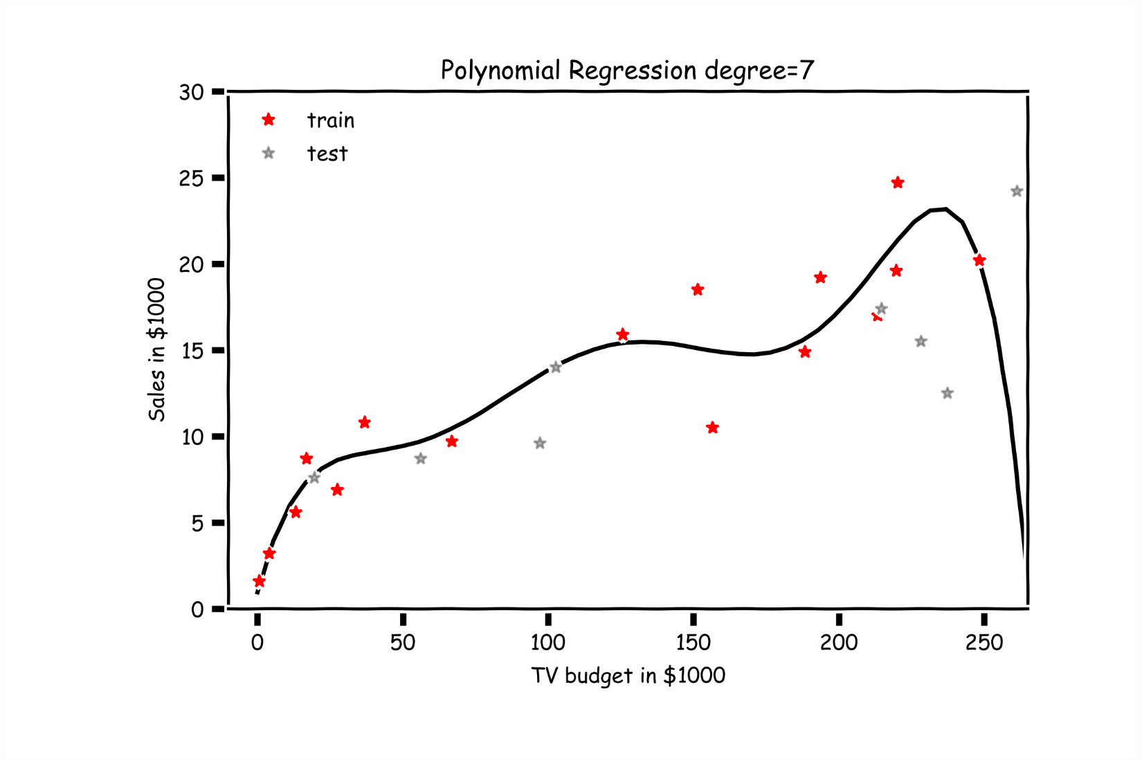
Overfitting

Slide 23
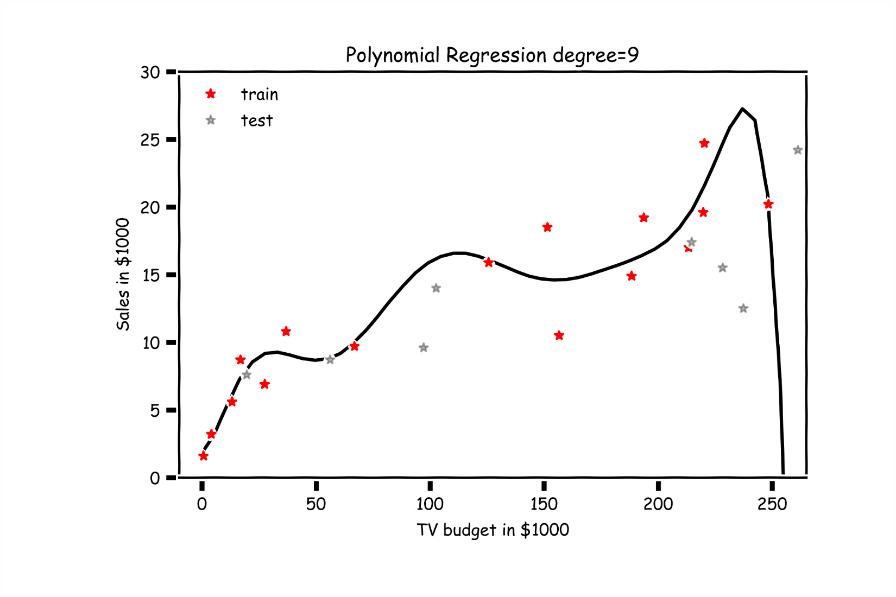
Overfitting

Slide 24
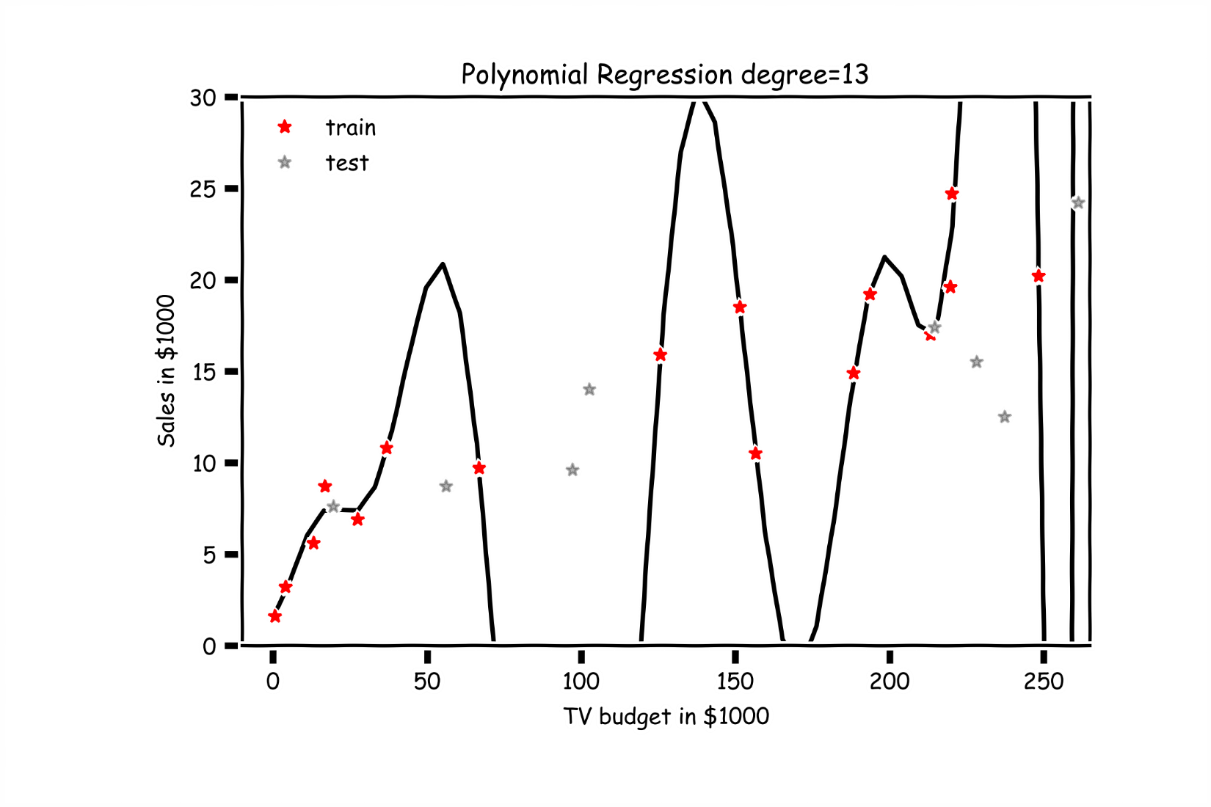
Overfitting

Slide 25
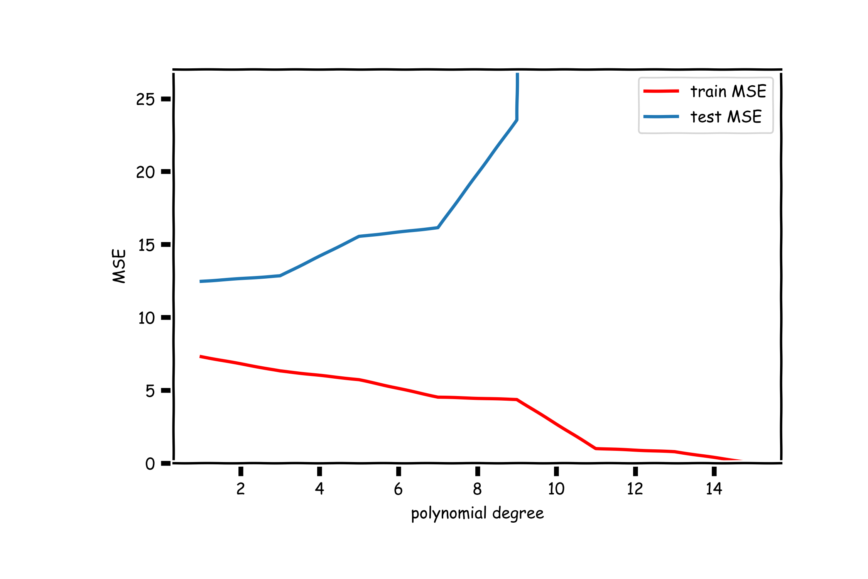
Validation

Slide 26
Content
Model Evaluation
Overfitting
Model Selection
Cross Validation
Bias vs Variance
Regularization: LASSO and Ridge

Slide 27
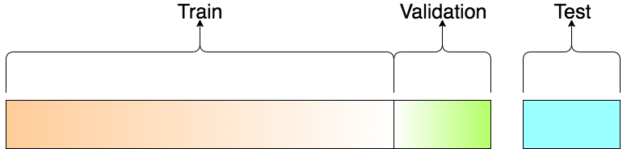
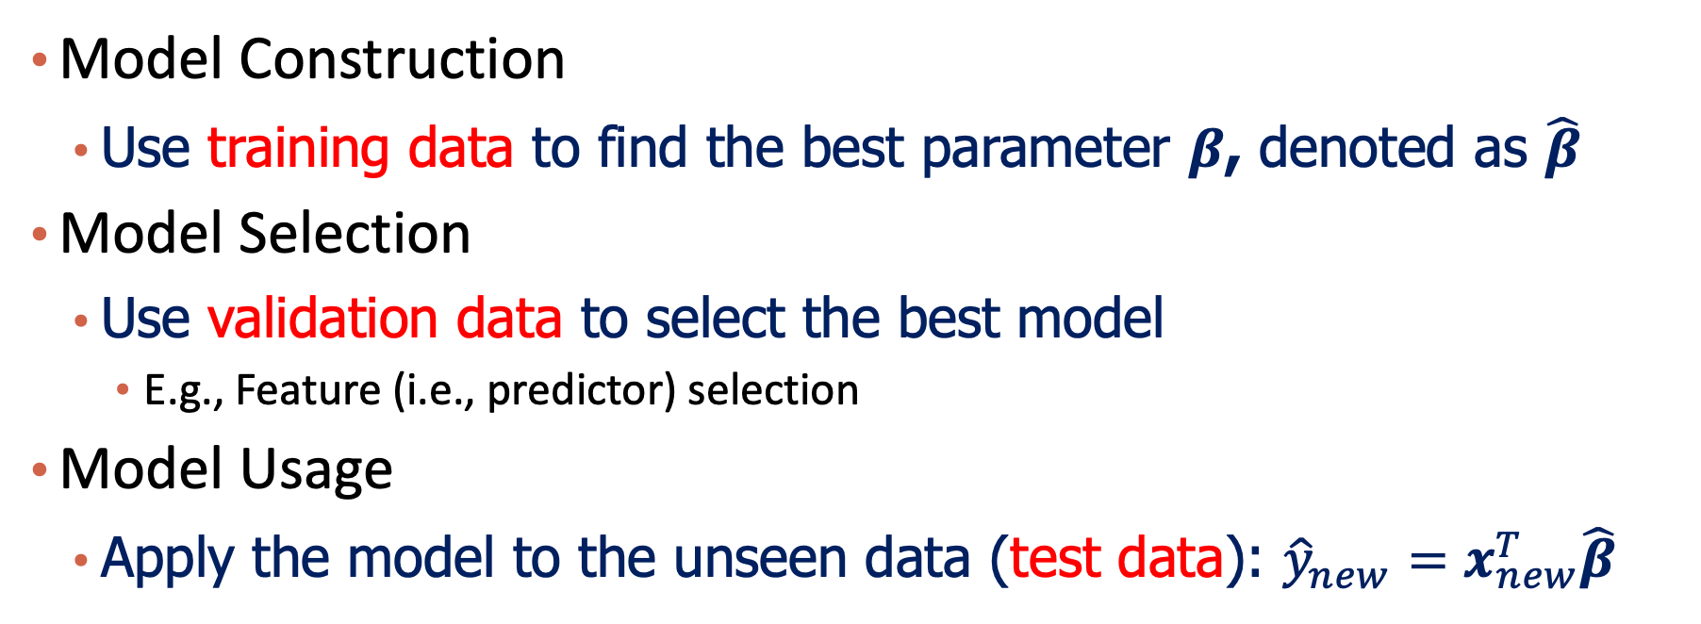
A 3-step Process: Train-Validation-Test
Model Construction
Use training data to find the best parameter $β$, denoted as $\hat{β}$
Model Selection
Use validation data to select the best model
E.g., Feature (i.e., predictor) selection
Model Usage
Apply the model to the unseen data (test data): ${\hat{y}}_{new}=x_{new}^{T}\hat{β}$
Notes:
In case they don’t understand the transpose notation, write it down explicitly.

Slide 28
Model Selection
Model selection is the application of a principled method to determine the complexity of the model, e.g. choosing a subset of predictors, choosing the degree of the polynomial model etc.
A strong motivation for performing model selection is to avoid overfitting, which we saw can happen when:
There are too many predictors:
the feature space has high dimensionality
the polynomial degree is too high
too many cross terms are considered
The coefficients are too extreme (we have not seen this yet)
Notes:
Cross terms / interaction terms

Slide 29
Model Selection
Question:
If one subset of predictors can produce one model, how many different models are there when considering J predictors?

Slide 30
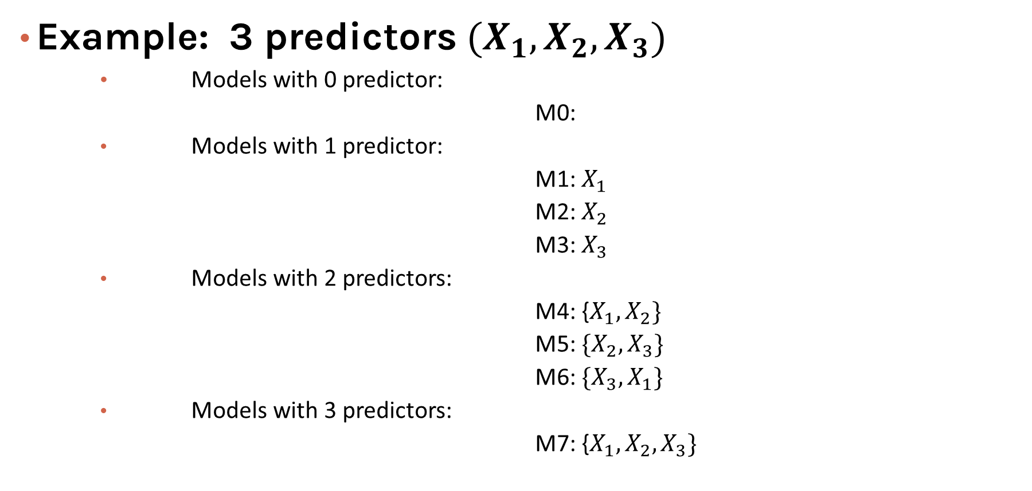

Model Selection
Example: 3 predictors $(X_{1},X_{2},X_{3})$
Models with 0 predictor:
M0:
Models with 1 predictor:
M1: $X_{1}$
M2: $X_{2}$
M3: $X_{3}$
Models with 2 predictors:
M4: {$X_{1},X_{2}\}$
M5: ${\{X}_{2},X_{3}\}$
M6: ${\{X}_{3},X_{1}\}$
Models with 3 predictors:
M7: {$X_{1},X_{2},X_{3}\}$
$$2^{J} Models$$

Slide 31
Stepwise Variable Selection and Cross Validation
Selecting (near)optimal subsets of predictors (including choosing the degree of polynomial models) through:
stepwise variable selection - iteratively building an optimal subset of predictors by optimizing a fixed model evaluation metric each time,
validation - selecting an optimal model by evaluating each model on validation set.
We will also address the issue of discouraging extreme values in model parameters later.

Slide 32
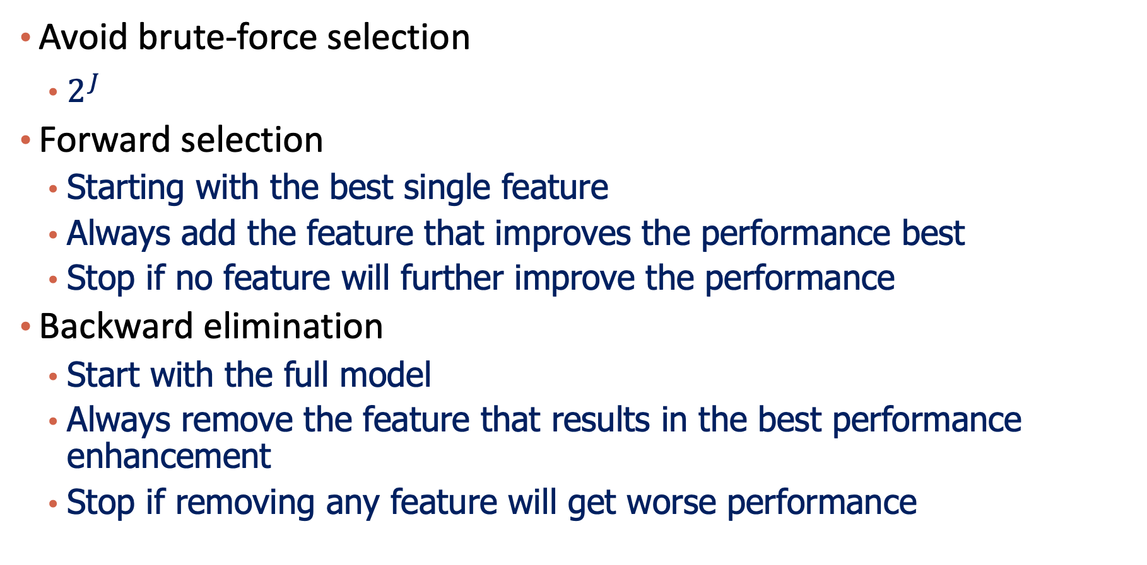
Stepwise Feature Selection
Avoid brute-force selection
$2^{J}$
Forward selection
Starting with the best single feature
Always add the feature that improves the performance best
Stop if no feature will further improve the performance
Backward elimination
Start with the full model
Always remove the feature that results in the best performance enhancement
Stop if removing any feature will get worse performance

Slide 33
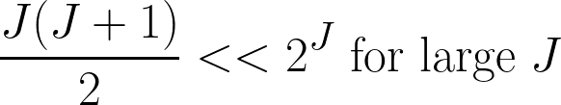
Stepwise Variable Selection Computational Complexity
How many models did we evaluate?
1st step, J Models
2nd step, J-1 Models (add 1 predictor out of J-1 possible)
3rd step, J-2 Models (add 1 predictor out of J-2 possible)
…

Slide 34
Please download and install the Slido app on all computers you use
Audience Q&A Session
ⓘ Start presenting to display the audience questions on this slide.

Slide 35
Content
Model Evaluation
Overfitting
Model Selection
Cross Validation
Bias vs Variance
Regularization: LASSO and Ridge

Slide 36
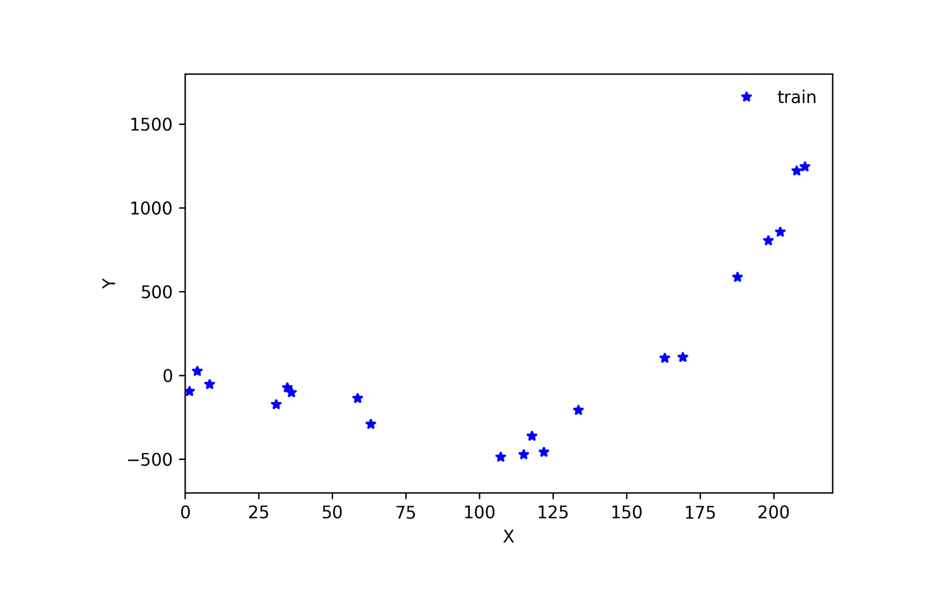
Validation

Slide 37
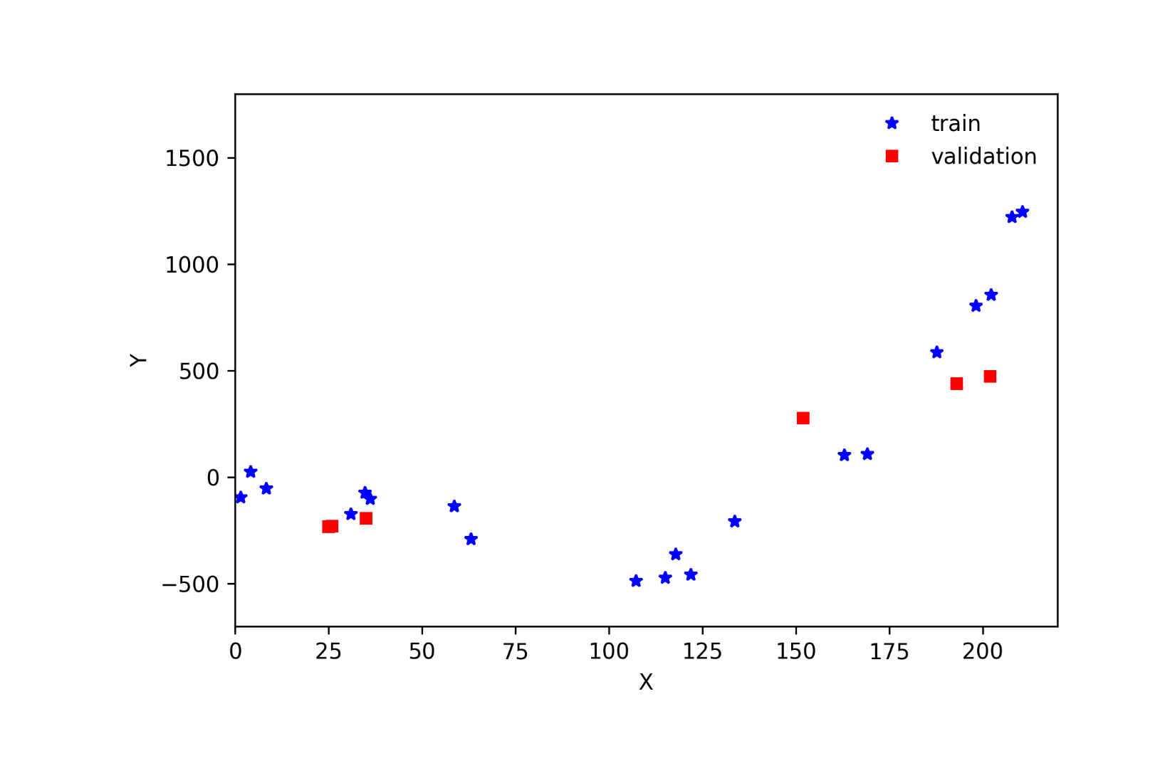
Validation

Slide 38
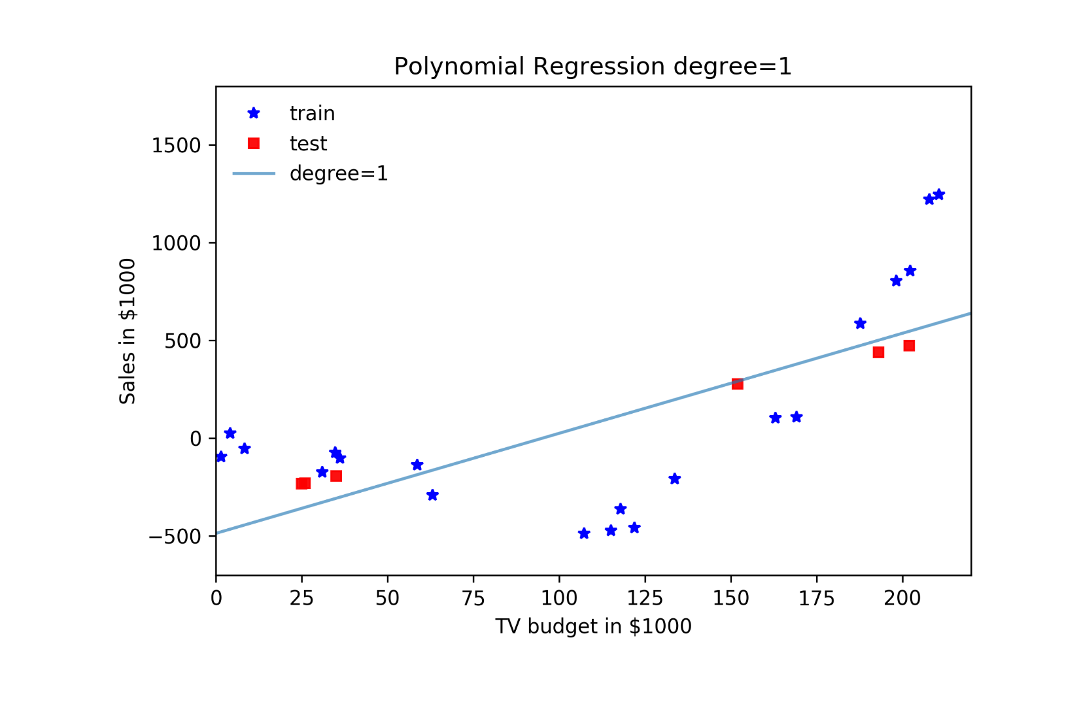
Validation

Slide 39
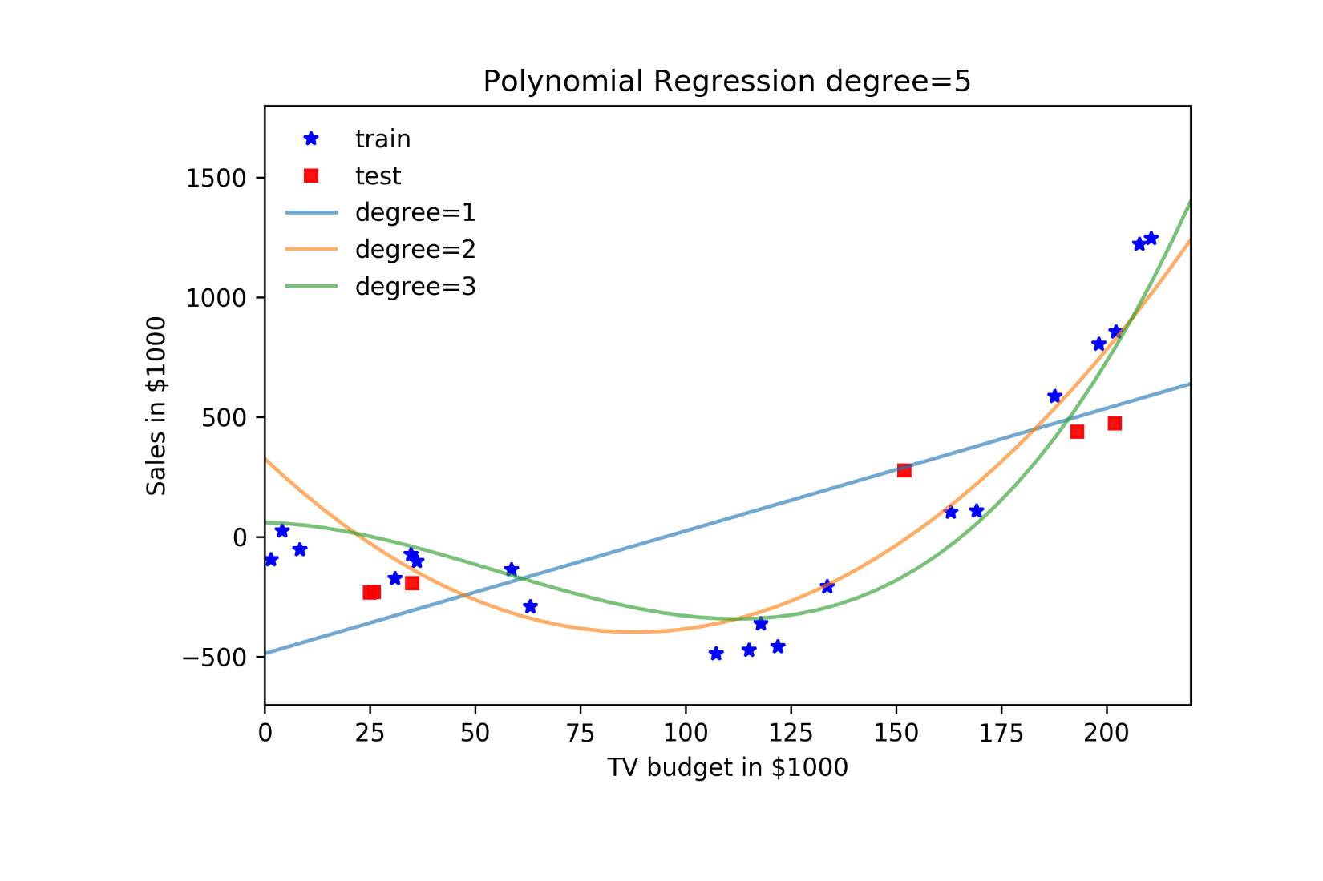
Validation

Slide 40
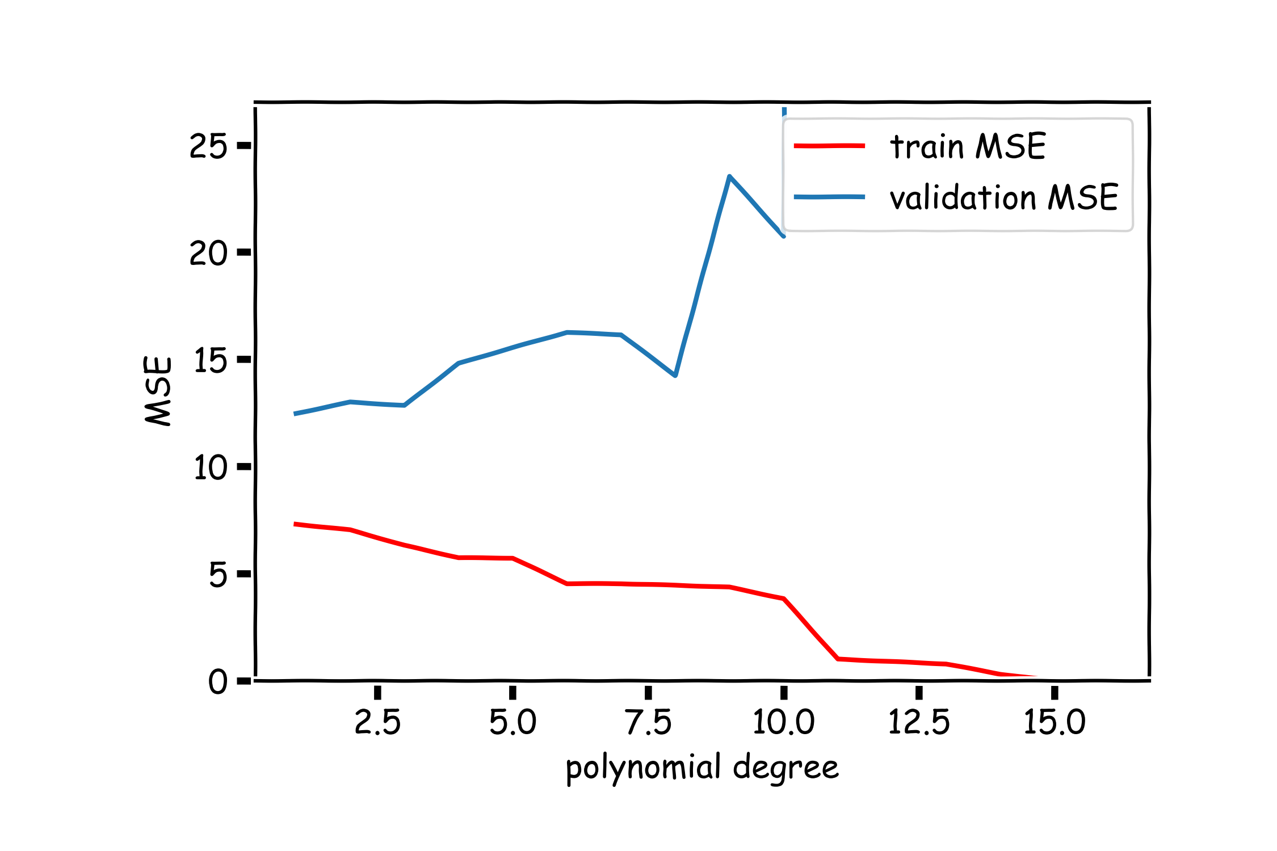
Validation

Slide 41
Cross Validation: Motivation
Using a single validation set to select amongst multiple models can be problematic - there is the possibility of overfitting to the validation set.
One solution to the problems raised by using a single validation set is to evaluate each model on multiple validation sets and average the validation performance.
One can randomly split the training set into training and validation multiple times but randomly creating these sets can create the scenario where important features of the data never appear in our random draws.

Slide 42
K-Fold Cross Validation

Slide 43
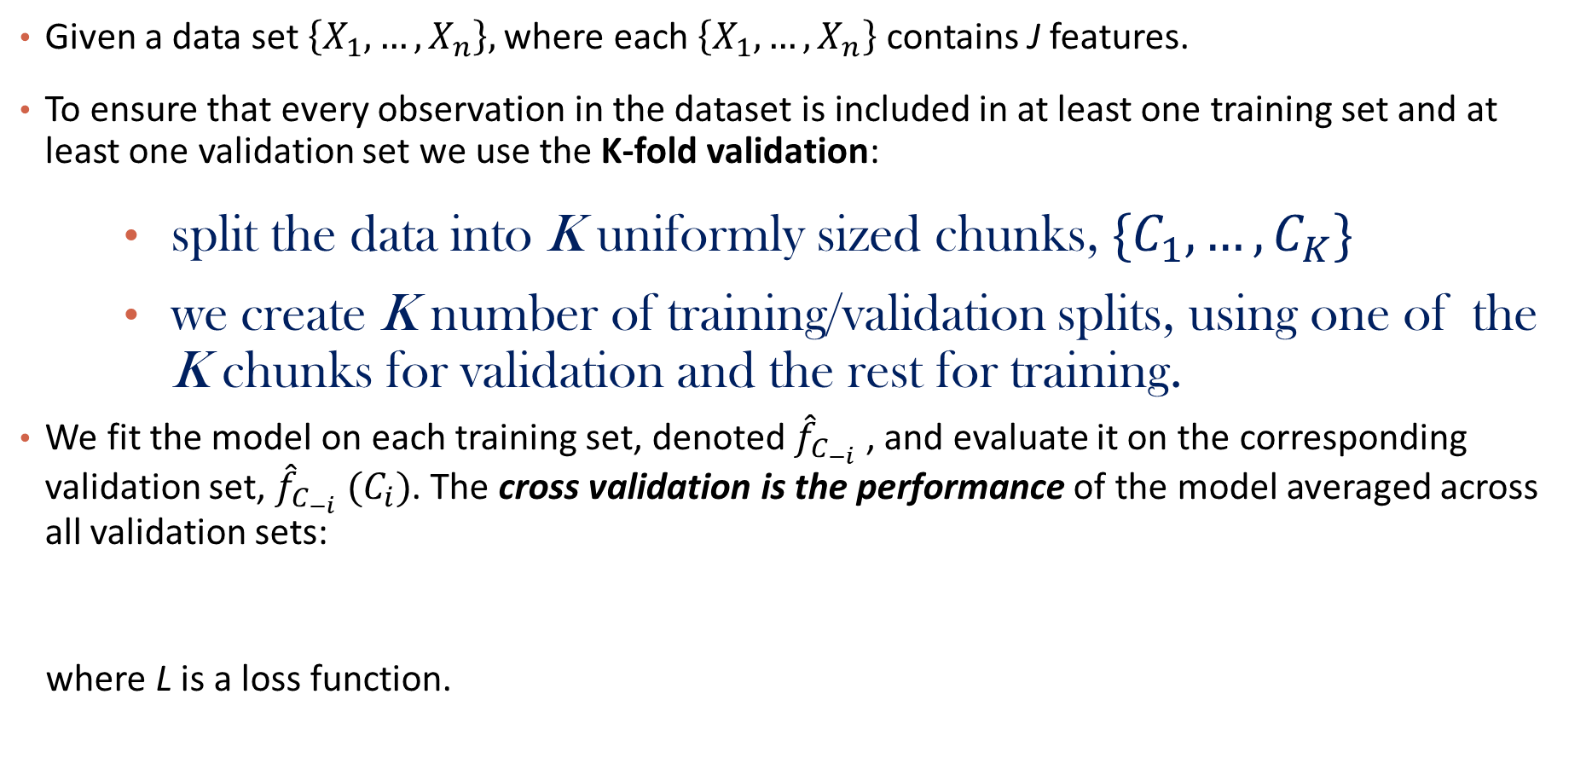
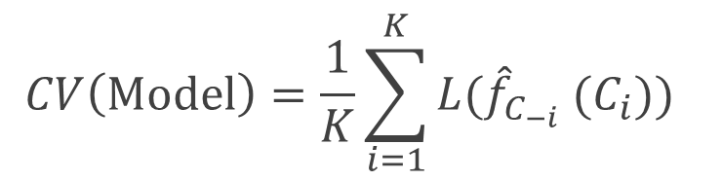
K-Fold Cross Validation
Given a data set $\left\{X_{1},…,X_{n}\right\},$ where each $\left\{X_{1},…,X_{n}\right\}$ contains J features.
To ensure that every observation in the dataset is included in at least one training set and at least one validation set we use the K-fold validation:
split the data into K uniformly sized chunks, $\{C_{1},…,C_{K}\}$
we create K number of training/validation splits, using one of the K chunks for validation and the rest for training.
We fit the model on each training set, denoted ${\hat{f}}_{C_{−i}}$ , and evaluate it on the corresponding validation set, ${\hat{f}}_{C_{−i}} (C_{i})$. The cross validation is the performance of the model averaged across all validation sets:
where L is a loss function.
$$CV\left(Model\right)=\frac{1}{K}\sum_{i=1}^{K}{{L(\hat{f}}_{C_{−i}} (C_{i})\text{)} }$$

Slide 44
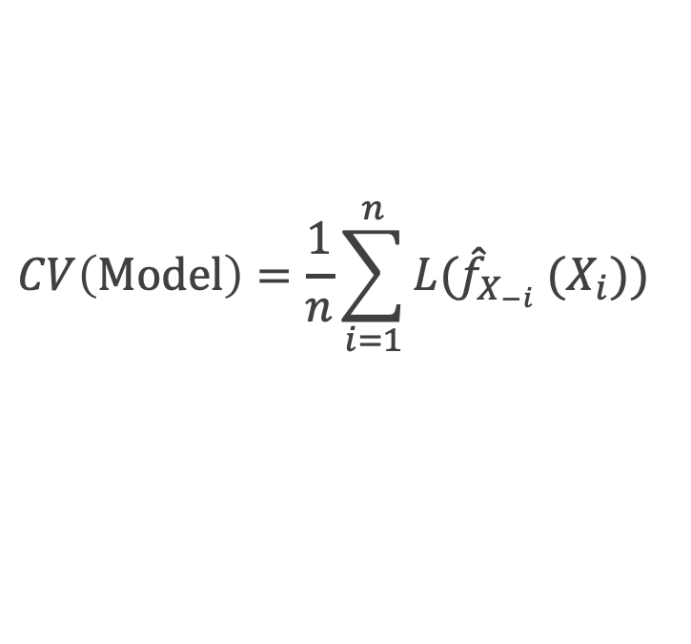
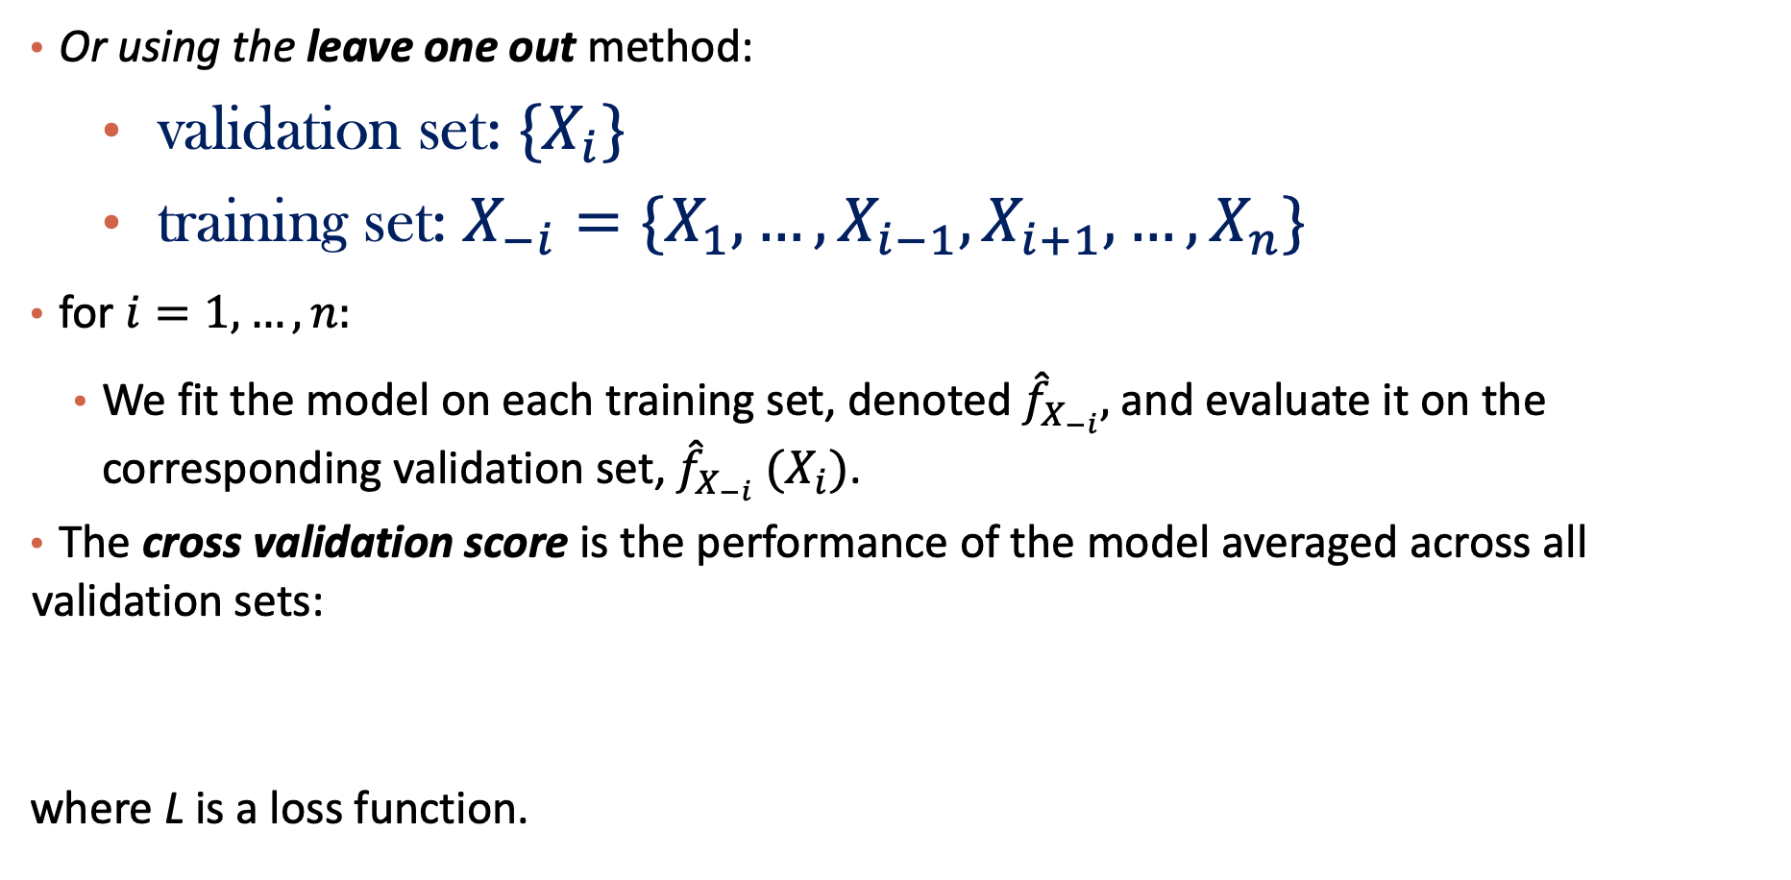
Leave-One-Out
Or using the leave one out method:
validation set: ${\{X}_{i}\}$
training set: $X_{−i}=\{X_{1}, …,X_{i−1},X_{i+1}, …, X_{n}\}$
for ${i=1,…,n: }_{}$
We fit the model on each training set, denoted ${\hat{f}}_{X_{−i}},$and evaluate it on the corresponding validation set, ${\hat{f}}_{X_{−i}} (X_{i})$.
The cross validation score is the performance of the model averaged across all validation sets:
where L is a loss function.
$$CV\left(Model\right)=\frac{1}{n}\sum_{i=1}^{n}{{L(\hat{f}}_{X_{−i}} (X_{i})\text{)} }$$

Slide 45
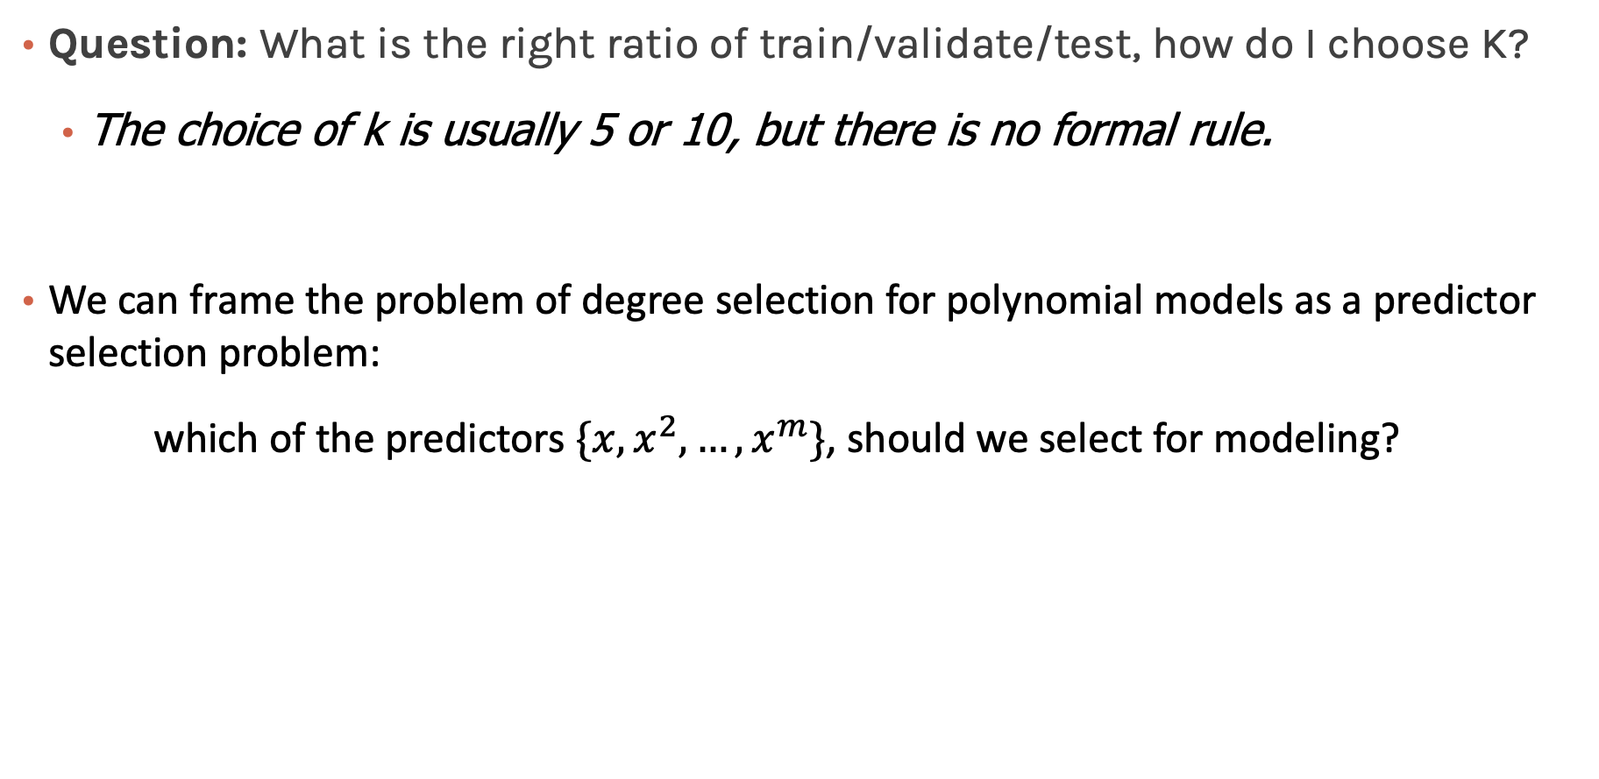
Predictor Selection: Cross Validation
Question: What is the right ratio of train/validate/test, how do I choose K?
The choice of k is usually 5 or 10, but there is no formal rule.
We can frame the problem of degree selection for polynomial models as a predictor selection problem:
which of the predictors $\{x, x^{2},…, x^{m}\}$, should we select for modeling?
Notes:
The choice of k is usually 5 or 10, but there is no formal rule. As k gets larger, the difference in size between the training set and the resampling subsets gets smaller. As this difference decreases, the bias of the technique becomes smaller

Slide 46
Please download and install the Slido app on all computers you use
Audience Q&A Session
ⓘ Start presenting to display the audience questions on this slide.

Slide 47
Content
Model Evaluation
Overfitting
Model Selection
Cross Validation
Bias vs Variance
Regularization: LASSO and Ridge

Slide 48
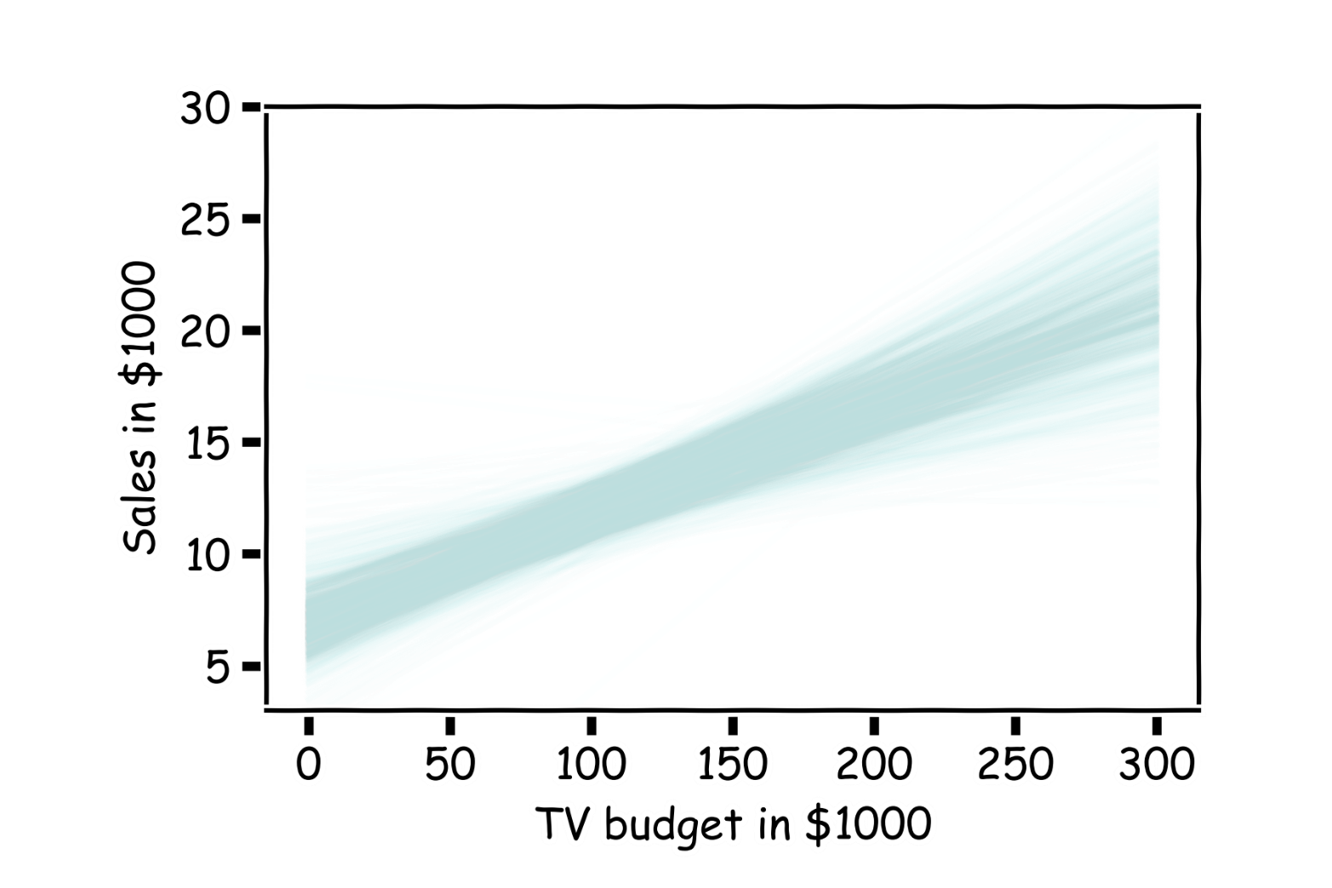
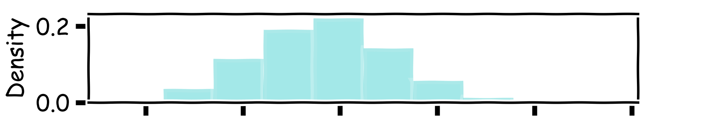
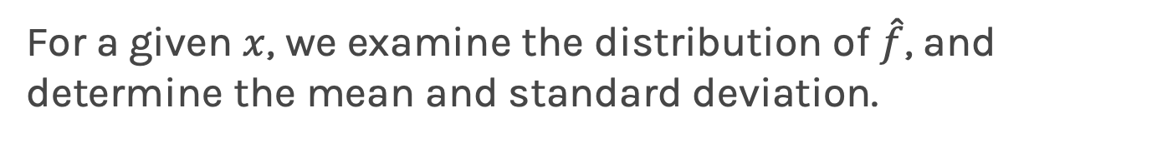
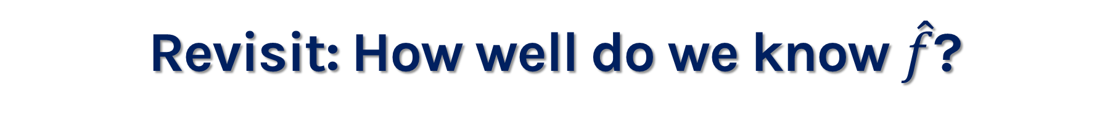
Revisit: How well do we know $\hat{f}$?
Below we show all regression lines for a thousand of such samples.
For a given $x$, we examine the distribution of $\hat{f}$, and determine the mean and standard deviation.

Slide 49
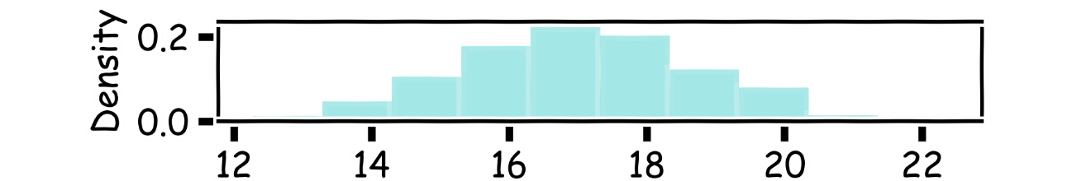
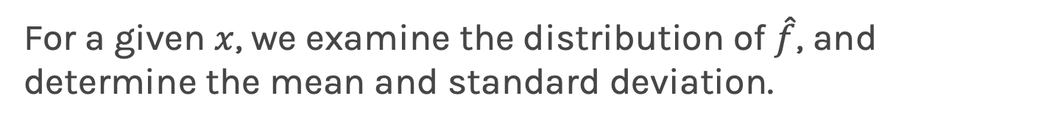
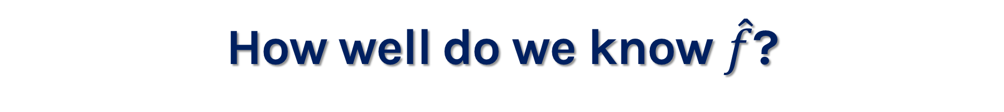
How well do we know $\hat{f}$?
Below we show all regression lines for a thousand of such samples.
For a given $x$, we examine the distribution of $\hat{f}$, and determine the mean and standard deviation.

Slide 50
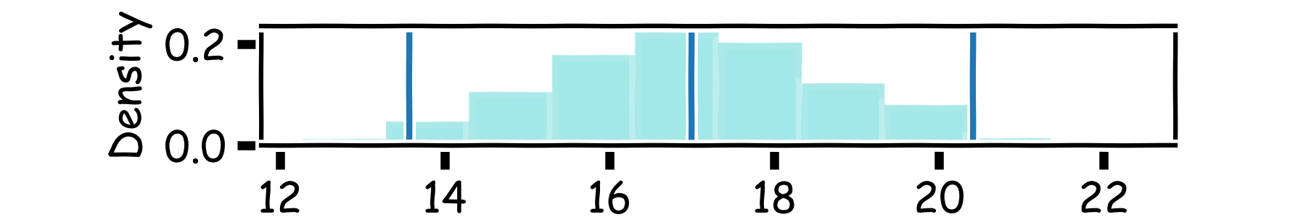
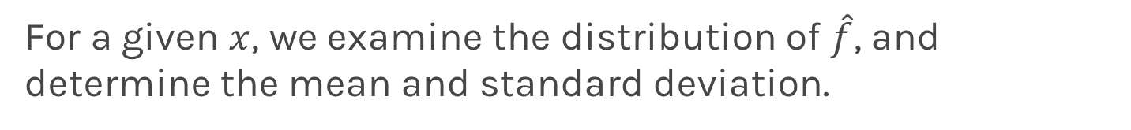
How well do we know $\hat{f}$?
Below we show all regression lines for a thousand of such samples.
For a given $x$, we examine the distribution of $\hat{f}$, and determine the mean and standard deviation.

Slide 51
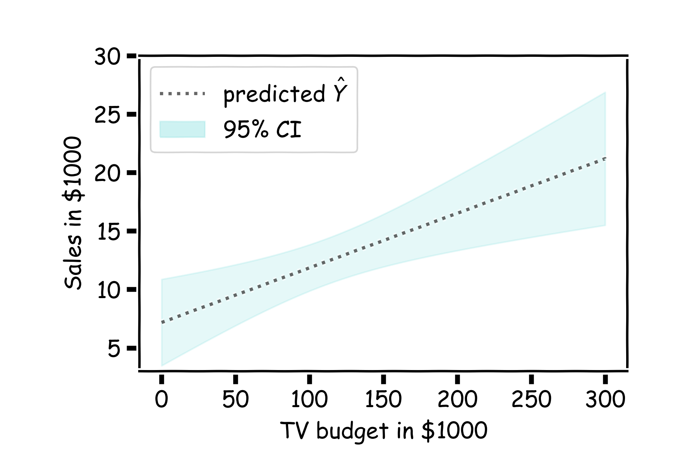
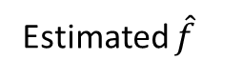
How well do we know $\hat{f}$?
For every $x$, we calculate the mean of the models, $\hat{f}$ (shown with dotted line) and the 95% CI of those models (shaded area).
Estimated $\hat{f}$

Slide 52

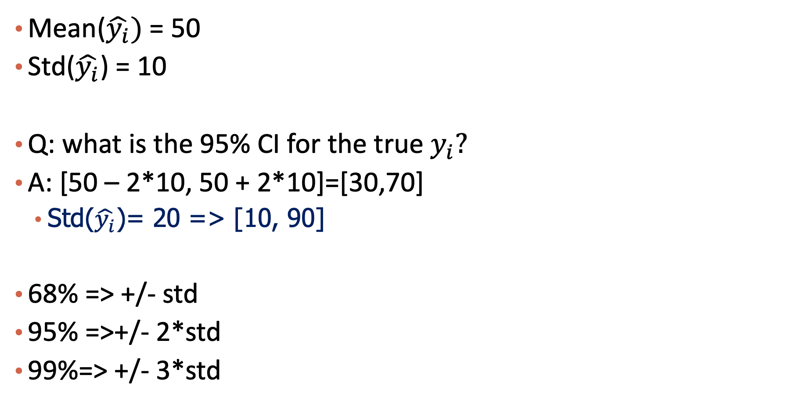
Example
Mean($\hat{y_{i}})$ = 50
Std($\hat{y_{i}}$) = 10
Q: what is the 95% CI for the true $y_{i}?$
A: [50 – 2*10, 50 + 2*10]=[30,70]
Std($\hat{y_{i}}$)= 20 => [10, 90]
68% => +/- std
95% =>+/- 2*std
99%=> +/- 3*std

Slide 53

Goodness of $\hat{f}$ in terms of Variance and Bias?

Slide 54



Bias and Variance
True model $f\left(x\right):x^{T}β$
Estimated model $\hat{f}\left(x\right):x^{T}\hat{β}$
Bias: $E(\hat{f}\left(x\right))−f(x)$
How far away is the expectation of the estimator to the true value? The smaller the better.
Variance: $Var\left(\hat{f}\left(x\right)\right)=E{[\left(\hat{f}\left(x\right)−E\left(\hat{f}\left(x\right)\right)\right)}^{2}]$
How variant is the estimator? The smaller the better.
Reconsider mean squared error
L$\left(\hat{β}\right)=\sum_{i}{{\left(x_{i}^{T}\hat{β}−y_{i}\right)}^{2}/n}$
Can be considered as
$E{[\left(\hat{f}\left(x\right)−f(x)−ε\right)}^{2}]=bias^{2}+variance+noise$
Note $E\left(ε\right)=0, Var\left(ε\right)=σ^{2}$
Notes:
Var(X) = E(X^2) – E^2(X)

Slide 55

Bias vs Variance

Slide 56

Bias vs Variance

Slide 57

Bias vs Variance

Slide 58

Linear models: 20 data points per line 2000 simulations

Slide 59

Bias vs Variance

Slide 60

Bias vs Variance

Slide 61

Bias vs Variance

Slide 62

Poly 10 degree models : 20 data points per line 2000 simulations

Slide 63
Bias vs Variance
Left: 2000 best fit straight lines, each fitted on a different 20 point training set.
Right: Best-fit models using degree 10 polynomial

Slide 64




Bias vs Variance
Left: Linear regression coefficients
Right: Poly regression of order 10 coefficients
$$β_{0}$$
$$β_{1}$$

Slide 65
Revisit Model Selection Problem
Basic problem:
how to choose between competing models, e.g., linear regression models
Model too simple:
“underfit” the data; poor predictions; high bias; low variance
Model too complex:
“overfit” the data; poor predictions; low bias; high variance
Model just right:
balance bias and variance to get good predictions

Slide 66


Example: degree d in regression
d=1: $f\left(x\right)=β_{0}+β_{1}x$
d=2: $f\left(x\right)=β_{0}+β_{1}x+β_{2}x^{2}$
d=3: $f\left(x\right)=β_{0}+β_{1}x+β_{2}x^{2}+β_{3}x^{3}$
d=4: $f\left(x\right)=β_{0}+β_{1}x+β_{2}x^{2}+β_{3}x^{3}+β_{4}x^{4}$
…
Notes:
https://towardsdatascience.com/polynomial-regression-bbe8b9d97491

Slide 68
Please download and install the Slido app on all computers you use
Audience Q&A Session
ⓘ Start presenting to display the audience questions on this slide.

Slide 69
Content
Model Evaluation
Overfitting
Model Selection
Cross Validation
Bias vs Variance
Regularization: LASSO and Ridge

Slide 70

Regularization: An Overview
The idea of regularization revolves around modifying the loss function L; in particular, we add a regularization term that penalizes some specified properties of the model parameters
where $λ$ is a scalar that gives the weight (or importance) of the regularization term.
Fitting the model using the modified loss function L_{reg} would result in model parameters with desirable properties (specified by R).

Slide 71





Regularization: An Overview
Assume the loss function L is MSE and $λ$ = 1

Slide 72
LASSO Regression
Since we wish to discourage extreme values in model parameter, we need to choose a regularization term that penalizes parameter magnitudes. For our loss function, we will again use MSE.
Together our regularized loss function is:
Note that is the l₁ norm of the vector β

Slide 73

LASSO Regression
Hence, we often say that L_{LASSO} is the loss function for l₁ regularization.
Finding the model parameters β_{LASSO} that minimize the l₁ regularized loss function is called LASSO regression.

Slide 74
Ridge Regression
Alternatively, we can choose a regularization term that penalizes the squares of the parameter magnitudes. Then, our regularized loss function is:
Note that is the l₂ norm of the vector β

Slide 75

Ridge Regression
Hence, we often say that L_{ridge} is the loss function for l₂ regularization.
Finding the model parameters β_{ridge} that minimize the l₂ regularized loss function is called ridge regression.

Slide 76
Choosing λ
In both ridge and LASSO regression, we see that the larger our choice of the regularization parameter λ, the more heavily we penalize large values in β,
If λ is close to zero, we recover the MSE, i.e. ridge and LASSO regression is just ordinary regression.
If λ is sufficiently large, the MSE term in the regularized loss function will be insignificant and the regularization term will force β_{ridge} and β_{LASSO} to be close to zero.
To avoid ad-hoc choices, we should select λ using cross-validation.

Slide 77
Questions
Q: when λ is bigger, do we get a more complex model or a simpler model?
A: simpler
Comment:
Put λ into a range: {0.1, 1, 10, 20, 50}

Slide 78




From Bias and Variance Perspective
Linear regression with regularization
Model: $f\left(x\right)=β_{0}+β_{1}x+β_{2}x^{2}+β_{3}x^{3}+β_{4}x^{4}$
L$\left(β\right)=\frac{1}{2n}\sum_{i}{{\left(f\left(x_{i}\right)−y_{i}\right)}^{2}+λ\sum_{j=1}{β_{j}^{2}}}$
Which one has the biggest $λ$? The smallest one?
Notes:
\theta_3 and 4 forced to be 0 in the middle figure

Slide 79
Ridge - Computational complexity
Solution to ridge regression:
The solution of the Ridge/Lasso regression involves three steps
Select λ
Find the minimum of the ridge/Lasso regression cost function (using linear algebra) as with the multiple regression and record the R² on the test set.
Find the λ that gives the largest R²

Slide 80

Lasso regularization with validation only: step by step
split data into $\{{\left\{X,Y\right\}}_{train},{\left\{X,Y\right\}}_{validation},{\left\{X,Y\right\}}_{test}\}$
for $λ in \left\{λ_{min},…λ_{max}\right\}:$
determine the $β$ that minimizes the $L_{lasso}$, ${\hat{β}}_{lasso}\left(λ\right)$, using the train data. This is done using a solver.
record $L_{MSE}^{}\left(λ\right)$ using validation data
select the $λ$that minimizes the loss on the validation data, ${ λ}_{lasso}={argmin}_{λ} L_{MSE}^{}\left(λ\right)$
Refit the model using both train and validation data, $\{{\left\{X,Y\right\}}_{train},{\left\{X,Y\right\}}_{validation}$ }, resulting to ${\hat{β}}_{lasso}\left(λ_{lasso}\right)$
report MSE or R² on ${\left\{X,Y\right\}}_{test}$ given the ${\hat{β}}_{lasso}\left(λ_{lasso}\right)$

Slide 81








Ridge regularization with CV: step by step
 | $$λ_{1}$$ | $$λ_{2}$$ | … | $$λ_{n}$$
$$k_{1}$$
$$k_{2}$$
…
$$k_{n}$$
 | $$λ_{1}$$ | $$λ_{2}$$ | … | $$λ_{n}$$
$$k_{1}$$ | $$L_{11}$$ | $$L_{12}$$ | .. | …
$$k_{2}$$ | $$L_{21}$$ | … | .. | …
… | .. | … | .. | …
$$k_{n}$$ | … | … | … | …
E[] | $${\overline{L}}_{1}$$ | $${\overline{L}}_{2}$$ | … | $${\overline{L}}_{n}$$
 | $$λ_{1}$$ | $$λ_{2}$$ | … | $$λ_{n}$$
$$k_{1}$$
$$k_{2}$$
…
$$k_{n}$$
 | $$λ_{1}$$ | $$λ_{2}$$ | … | $$λ_{n}$$
$$k_{1}$$ | $$L_{11}$$ | $$L_{12}$$ | .. | …
$$k_{2}$$ | $$L_{21}$$ | … | .. | …
… | .. | … | .. | …
$$k_{n}$$ | … | … | … | …
 | $$λ_{1}$$ | $$λ_{2}$$ | … | $$λ_{n}$$
$$k_{1}$$ | $$L_{11}$$
$$k_{2}$$
…
$$k_{n}$$
 | $$λ_{1}$$ | $$λ_{2}$$ | … | $$λ_{n}$$
$$k_{1}$$ | $$L_{11}$$ | $$L_{12}$$ | .. | …
$$k_{2}$$ | $$L_{21}$$ | … | .. | …
… | .. | … | .. | …
$$k_{n}$$ | … | … | … | …
E[] | $${\overline{L}}_{1}$$ | $${\overline{L}}_{2}$$ | … | $${\overline{L}}_{n}$$
 | $$λ_{1}$$ | $$λ_{2}$$ | … | $$λ_{n}$$
$$k_{1}$$
$$k_{2}$$
…
$$k_{n}$$
remove ${\left\{X,Y\right\}}_{test}$ from data
split the rest of data into K folds, $\{{\left\{X,Y\right\}}_{train}^{−k},{\left\{X,Y\right\}}_{val}^{k}\}$
for k in $\left\{1,…,K\right\}$
for $λ in \left\{λ_{0,}…{, λ}_{n}\right\}:$
determine the $β$ that minimizes the $L_{ridge}$, ${\hat{β}}_{ridge}\left(λ,k\right)={\left(X^{T}X+λI\right)}^{−1}X^{T}Y$ , using the train data of the fold, ${\left\{X,Y\right\}}_{train}^{−k}$.
record $L_{MSE}^{}\left(λ,k\right)$ using the validation data of the fold ${\left\{X,Y\right\}}_{val}^{k}$
At this point we have a 2-D matrix, rows are for different k, and columns are for different $λ$ values.
Average the $L_{MSE}(λ,k)$ for each $λ$, ${{\overline{L}}_{MSE}\left(λ\right)}_{}$.
Find the $λ$ that minimizes the ${{\overline{L}}_{MSE}\left(λ\right)}_{}$, resulting to $λ_{ridge}$.
Refit the model using the full training data, $\{{\left\{X,Y\right\}}_{train},{\left\{X,Y\right\}}_{val}$ }, resulting to ${\hat{β} }_{ridge}\left(λ_{ridge}\right)$
report MSE or R² on ${\left\{X,Y\right\}}_{test}$ given the ${\hat{β}}_{ridge}\left(λ_{ridge}\right)$

Slide 82

Ridge regularization with validation only: step by step

Slide 83
Variable Selection as Regularization
Since LASSO regression tend to produce zero estimates for a number of model parameters - we say that LASSO solutions are sparse - we consider LASSO to be a method for variable selection.
Many prefer using LASSO for variable selection (as well as for suppressing extreme parameter values) rather than stepwise selection, as LASSO avoids the statistic problems that arises in stepwise selection.
Notes:
Forward:
Computationally feasible with big data
Efficient computations with squared-error loss.
Tedious with very large p and n
Lasso:
Extremely fast algorithms for solving lasso
With large p provides convenient subset selection
Since coefficients are both selected and regularized, can suffer from shrinkage bias - If two predictors are highly correlated LASSO can end up dropping one rather arbitrarily. - difficulty of doing hypothesis testing. You can't easily figure out which variables are statistically significant with Lasso.

Slide 84
(optional) Why not Both?
This is a problem that often appears in technical interviews at companies
If you are curious, search on Google “use L1 and L2 regularization together”

Slide 85

Summary
Model Evaluation
Training, test
MSE, MAE, $R^{2}$
Overfitting
Model Selection
Cross validation
Bias and variance
Regularization
Ridge (l2), lasso (l1)

Slide 86
Please download and install the Slido app on all computers you use
Audience Q&A Session
ⓘ Start presenting to display the audience questions on this slide.

Slide 87

Please download and install the Slido app on all computers you use
which parts do you find the most challenging?
ⓘ Start presenting to display the poll results on this slide.

